Slide 2
Cultural and Creative Spaces and Cities
28 month-long Creative Europe project with experimental angle
A culture of commons as our political vision for EU project
How could community-led organizations contribute to create public policies and how could they become responsible for their implementation?

Slide 3
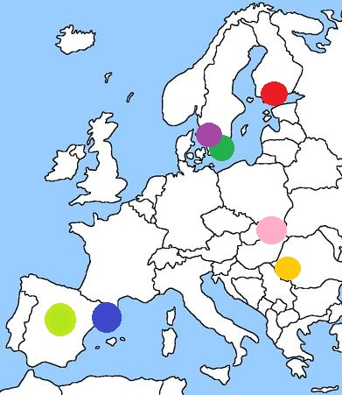
The 7 Urban Labs
Kaapeli - FI
Lund - SE
Skane Region - SE
Cike - SK
Ambasada - RO
CoboiLab - ES
Hablarenarte - ES

Slide 4
A value-based approach
A “Charter of principles”: a shared vision as the starting point
Indicators based on values of the charter, fostering understanding, not evaluating
Peer-to-peer exchanges and mutual learning

Slide 5
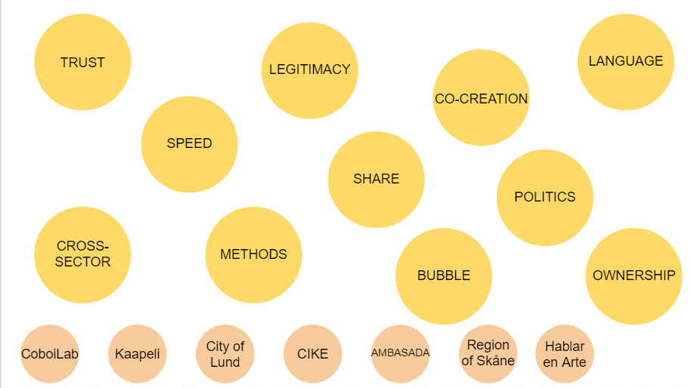
The common questions

Slide 6
Why ‘homes of commons’?
After the outbreak of Covid-19:
urgency to learn from local solidarity initiatives
need to change relationship between the EU and local level
re-center the CCSC recommendations
focus the CCSC policy event around imagining new spaces of encounter between policy-makers, cultural workers and citizens

Slide 7
Challenge 1: The commons as ecosystems for culture after Covid-19
Accessible EU policies and grants for commons and alternative cultural spaces: how can we establish methodologies and about who is legitimised “to speak on behalf of the sector” for a participatory cultural policy–making and grant co-creation together with the EU level?
Cultural policies and grants to activate new commons-based ecosystems: how to promote a sustainable creative work (i.e. allowing space and time for research and production, peer learning, income, and relationship with society)?
Going beyond the logic of ‘big events’ and hypermobility: how can cultural and creative work be made more sustainable, in particular linked to/after Covid-19, as well as from a green perspective?

Slide 8
Challenge 2: co-creating cultural policies in cities to foster cohesion and inclusion
Incentives for participation: should remuneration (financial or non-financial) be included in participatory processes?
Culture in urban policy: how to overcome in-silo approaches in urban policy?Can cross-sectoral approaches; needs-based approaches; stronger mediation/facilitation work as solutions?
Participation and post-covid Europe: in what ways can local authorities recognise, valorise and support local solidarity initiatives?

Slide 9
Challenge 3: Building spaces of encounter between local and EU level
Organisation of the ‘homes of commons’: how can homes of commons act as effective tools to decentralise EU institutions and foster a dialogue with the local contexts? How can homes of commons communicate and collaborate simultaneously with EU institutions, local authorities and citizens?
Agenda of the homes of commons: what should be on the agenda of homes of commons, in order to facilitate the links between the EU and the local level? What function should homes of commons have (advocacy, information, co-creation, local participation…)?
Homes of commons and cultural and creative spaces: how can we rethink cultural and creative spaces as community organisations suggesting new ways for the EU to relate with the local level, aware of the role of relevant national/regional level organisations ?

Slide 10
Thank you

