Slide 1
The Co-Creation Lab – An Overview
Time Line and Key Moments
Wed 24 June – The Co-Creation work space on Slack is open to all participants.
Sun 28 June
Monday 29 June
09:00-09:30 Opening of the Lab and check-in on Zoom
15:00-18:00 Check points with mentors
18:00-18.45 After-work check-out on Zoom including an interactive art piece
Tuesday 30 June
09:00-09.15 Check-in on Zoom
09:45-12.30 Check points with mentors
16:00 Deadline for submissions
17:00-18:00 Wrap-up on Zoom with Maciej Hofman and Barbara Stacher
from the European Commission
Notes:
Slack is a collaboration platform organised in different channels that is ideal for online cooperation.

Slide 2
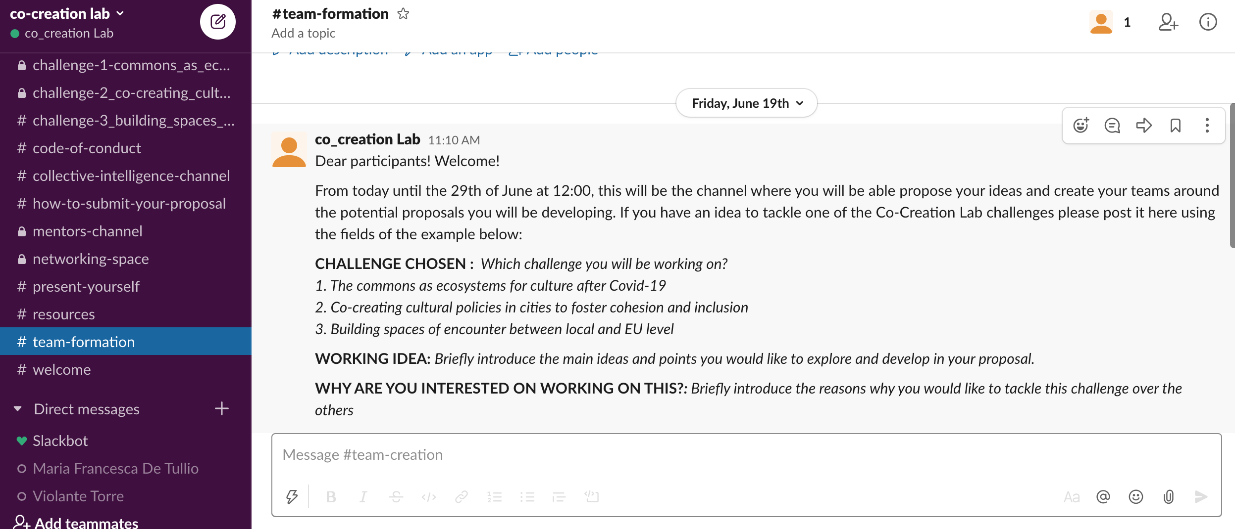
The Co-Creation Lab – Team Formation
The Co-Creation Lab will mainly happen on Slack.
Slack will open on Wednesday 24th of June
HOW TO CREATE A TEAM ?
Join the #team-formation channel and present your ideas or join any idea proposal you would like to work on!
Notes:
Slack is a collaboration platform organised in different channels that is ideal for online cooperation.

Slide 3
The Co-Creation Lab – Team Formation
Propose your idea: in order to propose your idea go to the SLACK #team-formation channel and post your idea following the proposed format:
CHALLENGE CHOSEN
WORKING IDEA TO TACKLE THIS CHALLENGE
WHY ARE YOU INTERESTED ON WORKING ON THIS?
Notes:
Slack is a collaboration platform organised in different channels that is ideal for online cooperation.

Slide 4
The Co-Creation Lab – Team Formation
Connect with an idea and make a team: in order to join an idea proposal you like, go to the SLACK #team-formation channel, read the ideas that have been posted and start a threat conversation with the idea proposal you would like to work on!
Notes:
Slack is a collaboration platform organised in different channels that is ideal for online cooperation.

Slide 5
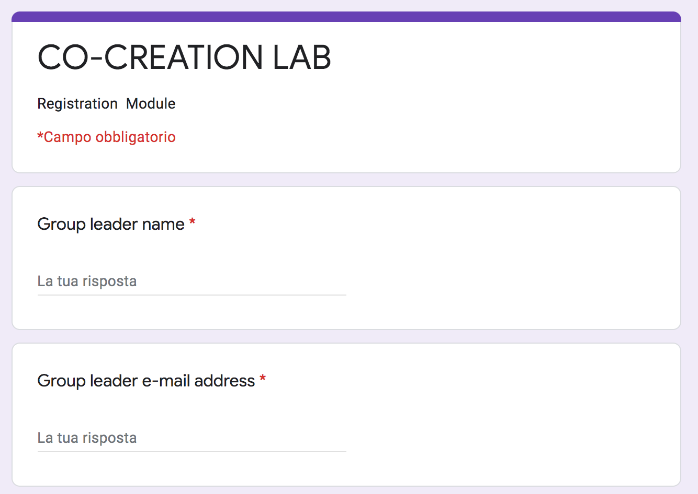
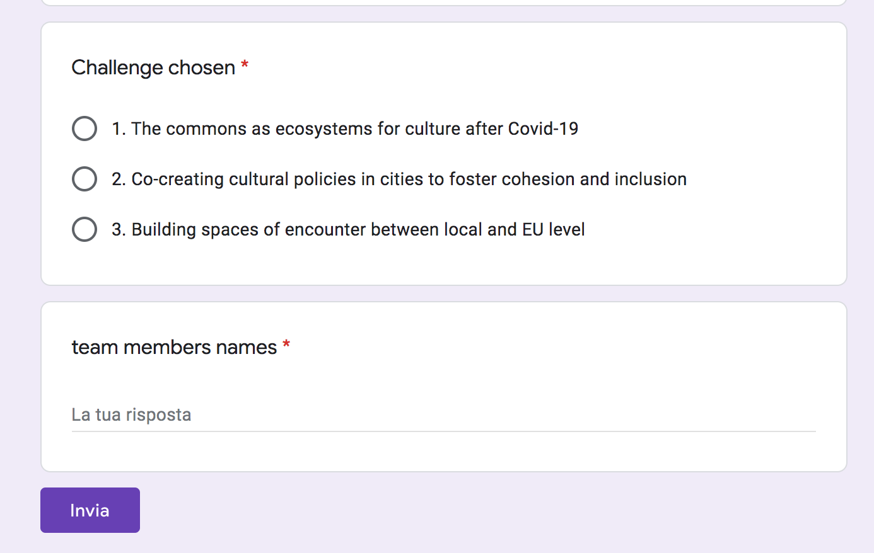
The Co-Creation Lab – Team Registration
Register your Team of 3-5 people at the latest Sunday 28th June midnight.
HOW CAN YOU REGISTER?
Go to the format linked in the #teamformation channel and register your team.
After registering, create your own #teamchannel in slack to start working.
Notes:
Slack is a collaboration platform organised in different channels that is ideal for online cooperation.

Slide 6
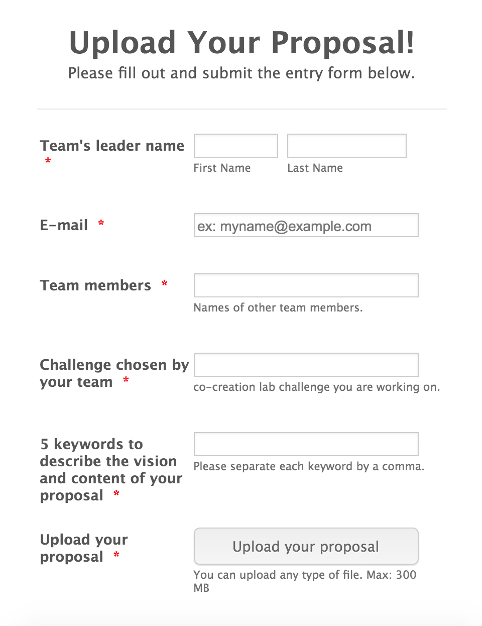
The Co-Creation Lab – Submitting a Proposal
Deadline for submissions is Tuesday 30 June, 16:00 Central European Summer Time (CEST)
• Use the Power Point Template for the Challenge you have chosen.
• Describe your Analysis and your Concrete Proposals in response to the Challenge and the sub-topics
• If you want to answer to another question than the sub-topic, do so and explain why!
• Stay with the Power Point template – use text, drawings, video, graphs freely to illustrate and make your points.
• Select 5 keywords, put on menti.com. Info on Slack.

