Slide 1
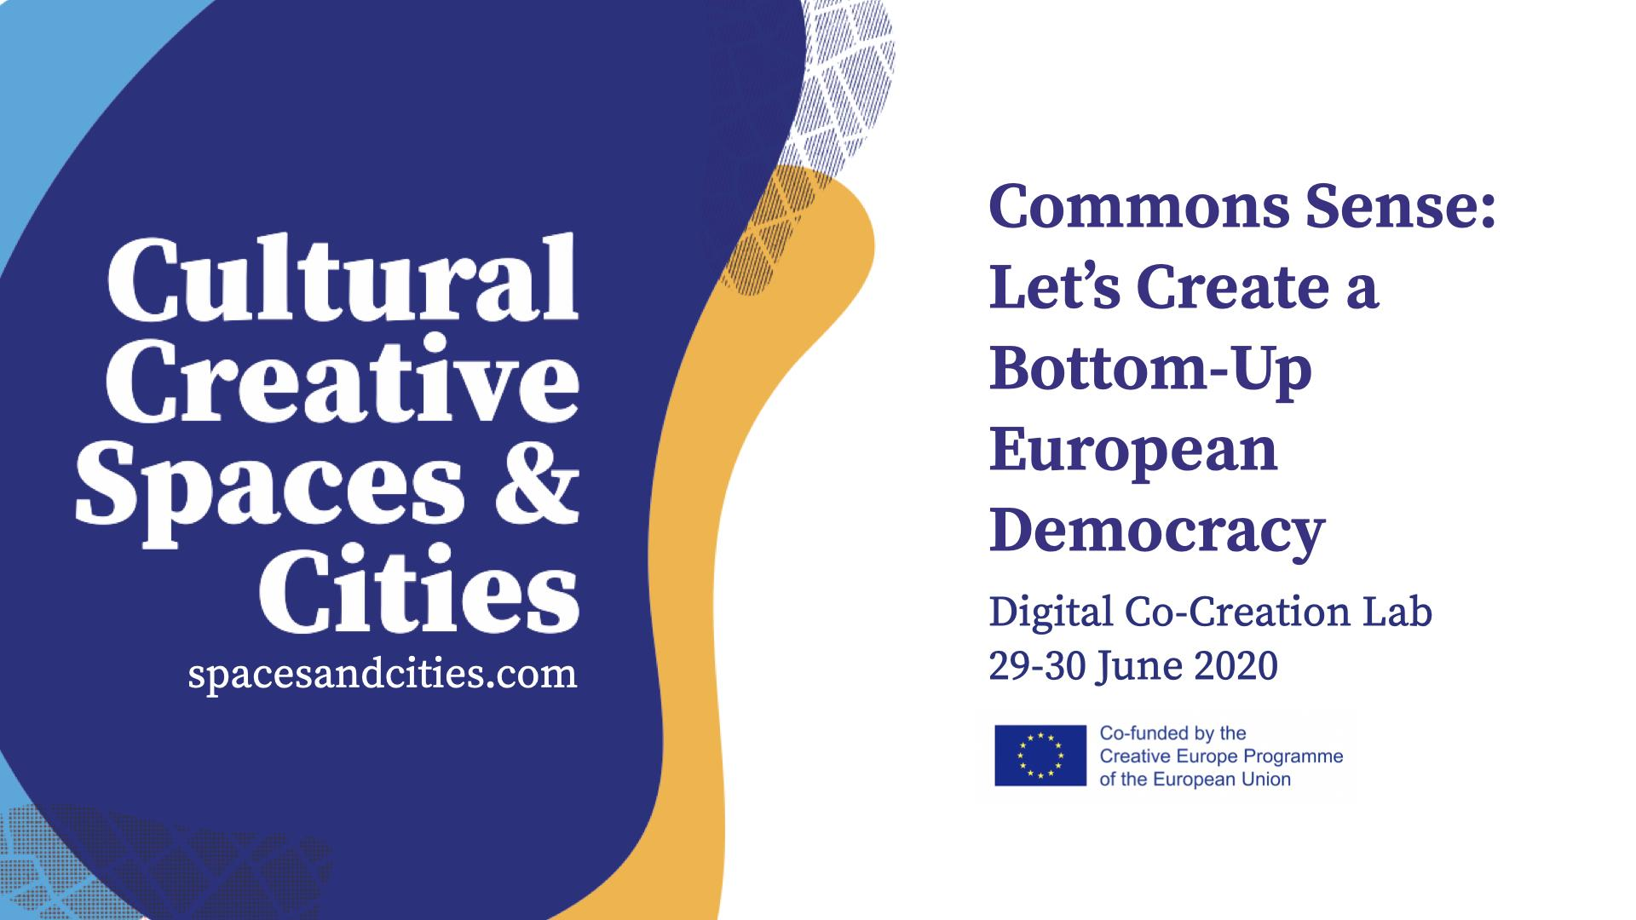

Slide 2
Commons Sense: Let’s Create a Bottom-Up
European Democracy
Digital Co-Creation Lab
29-30 June 2020
spacesandcities.com

Slide 3
Proposal Submission Instructions
Dear team,
please use this format to deliver your proposal. We ask you to provide an analysis and a concrete proposal for each of the subtopics of the challenge you chose to focus on. Finally, we ask you to write 5 keywords for each subtopic (slide 12). If you think that one or more of the subtopics is not relevant, you can provide an alternative solution (and keywords) to the challenge, giving a reason why you deem the original subtopic not relevant.
Any doubts?
Check the guidelines!

Slide 4
Co-Creation Lab Proposal
Challenge Nr 3: Building spaces of encounter between local and EU level
Team:
ARTCROSS
Names of team members:
KETEVAN PAITCHADZE, MIKA TBILELI, NICOLOZ TBILELI

Slide 5
3.1 Concrete proposals to bring Europe closer to citizens and cultural operators – Organisation of the ‘homes of commons’: how can homes of commons act as effective tools to decentralise EU institutions and foster a dialogue with the local contexts? How can homes of commons communicate and collaborate simultaneously with EU institutions, local authorities and citizens?
In spite EU being united organization with common goals for all EU countries ,local context for every city and every country is unique and different. funding as well as policies and projects are not created to the local context, but vise-versa .Dialog between commons, artists and EU institutions is not flexible .Process are overly time consuming. And Information regarding funding and activities are not accessible to communities . There is no clearly defined system for bottom up communication ,project management and policy regulation. lack of urban context and participation of wide community , society stagnates rapid development of art sector. Instead of having many small impactful events and projects at the moment all of the attention is shifted towards few big events . Having too many circles leaves big room for miscommunication and interpretation of different projects and fundings.in the end there is big confusion in art community making progress take extremely difficult.

Slide 6
3.1 Concrete proposals to bring Europe closer to citizens and cultural operators – Organisation of the ‘homes of commons’: how can homes of commons act as effective tools to decentralise EU institutions and foster a dialogue with the local contexts? How can homes of commons communicate and collaborate simultaneously with EU institutions, local authorities and citizens?
Our team invasion solving existing issues of miscommunication between commons and EU. Bringing Urban and city projects closer to decision makers and opening conversations between creators initiators and EU that are distanced currently. We see solution in creating new architecture by forming new intermediary hybrid platform giving solution and opportunity both to bottom up and top to bottom communication those bridging unwritten gap. Proposed hybrid platform COMMO EUROPE , won’t only act as a online database but a platform that will help co-creation labs ,artists ,commons and EU to connect and give them a voice , and a better way to represent themselves and let them connect on the global scale. The hybrid platform is solution for post Covid-19 adaptation and new opportunity to build straight communication line, for artists and commons as well to EU those making funding, searching for collaboration and co-creation, easy on local level and enhancing north south and south south exchange. The hybrid platform will take on all the complicated bureaucratic arrangement and complicated structural procedures and give artists and commons opportunity to produce tangible results bringing much needed support to the communities for fast and effective development.

Slide 7
3.1 Concrete proposals to bring Europe closer to citizens and cultural operators – Organisation of the ‘homes of commons’: how can homes of commons act as effective tools to decentralise EU institutions and foster a dialogue with the local contexts? How can homes of commons communicate and collaborate simultaneously with EU institutions, local authorities and citizens?
What is your Concrete Proposal? Please explain and illustrate here. You can use text, photos, drawing, video, illustrations, graphs, whatever!

Slide 8
3. 2 Concrete proposals to bring Europe closer to citizens and cultural operators – Agenda of the homes of commons: what should be on the agenda of homes of commons, in order to facilitate the links between the EU and the local level? What function should homes of commons have (advocacy, information, co-creation, local participation…)?
As analyzed, There is not just gap in communication between EU and commons, artists but there is also a issue of distributing information locally .Accordingly this issue leads to miscommunication between EU and the local level. Causing the policies and the actions to be ineffective.

Slide 9
3. 2 Concrete proposals to bring Europe closer to citizens and cultural operators – Agenda of the homes of commons: what should be on the agenda of homes of commons, in order to facilitate the links between the EU and the local level? What function should homes of commons have (advocacy, information, co-creation, local participation…)?
Our hybrid platform is oriented to not just connect EU and commons but to connect all EU countries ,commons and artists giving all the cities their own platform which will unit under one roof . Creating a one big art community .

Slide 10
3.3 Homes of commons and cultural and creative spaces: how can we rethink cultural and creative spaces as community organisations suggesting new ways for the EU to relate with the local level, aware of the role of relevant national/regional level organisations ?
problem of physical spaces as well as digital spaces where all the information shall be gathered, and opportunities given to all the local and regional organizations as well as urban communities is big obstacle that all creatives have to face alone because of lack of unity.

Slide 11
3.3 Homes of commons and cultural and creative spaces: how can we rethink cultural and creative spaces as community organisations suggesting new ways for the EU to relate with the local level, aware of the role of relevant national/regional level organisations ?
We not only envision online platforms but physical havens for creatives to collaboration and co-creation. In our opinion it is important if not on city level that on regional level EU have a representative on the platform. Those making bridging of ideas and interaction seamless .On the one hand we are linking with this platform local art communities and urban society to commons as well giving general public possibility themselves towards relativity of the projects . Platform will give opportunity for all artists and communities to upload their ideas to already defined structure agreed with EU and involving art community as well as general community in decision making. The platform will insure the fast development of art and in this pandemic crisis situation we find much more important .Artists need tools for progress as much as essential workers as doctors and nurses need hospitals and health equipment. With COMMO EUROPE we are giving all community all the necessary tools .

Slide 12
Our 5 Keywords
Challenge Nr 3: Building spaces of encounter between local and EU level
Please insert here 5 keywords that best describe your proposal.
Georgia: Not a “Developing Country”!!!!!
Hybrid Platform,
COMMA EUROPE,
CHANGE ,
UNITING ART COMMUNITY .
You should also post these on menti.com. The code for menti.com will be announced on Slack.

