Slide 1
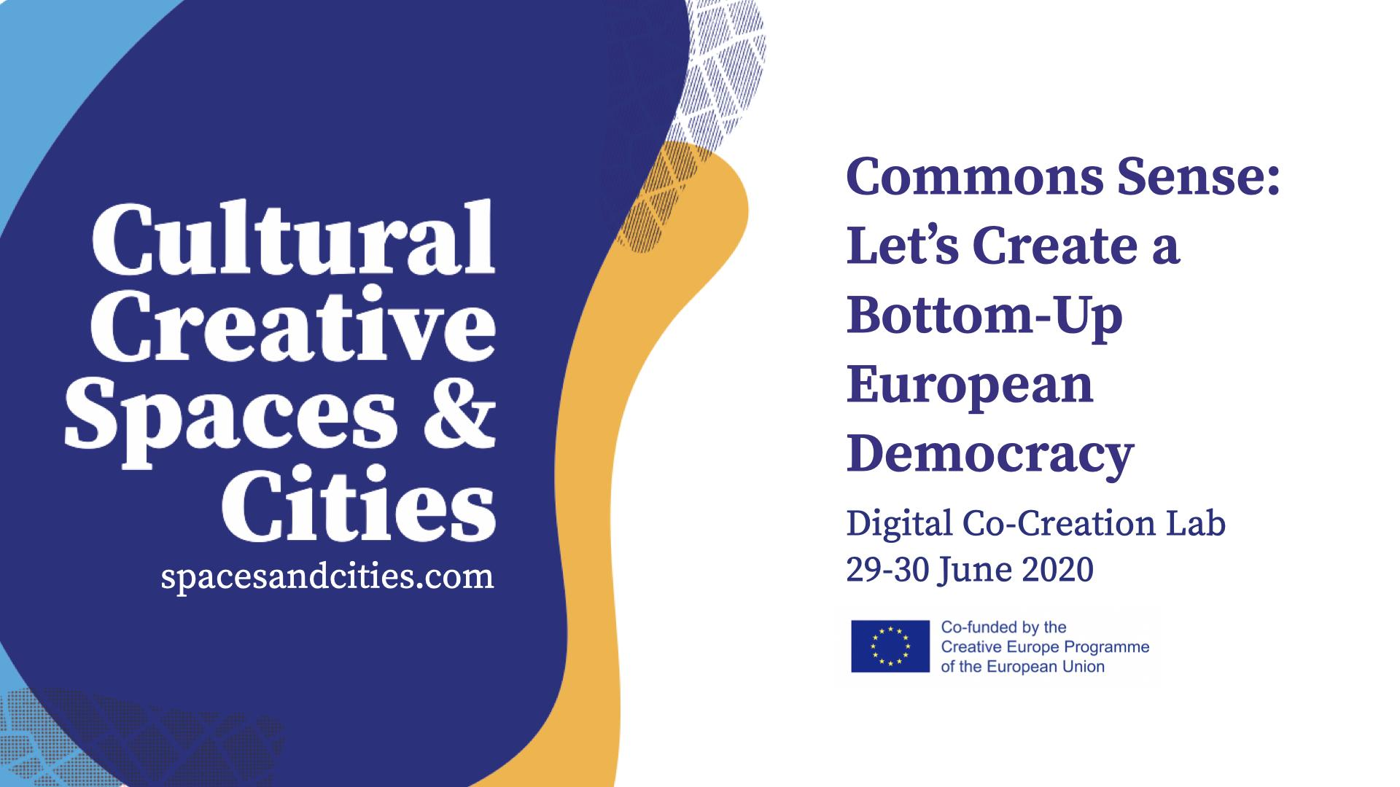

Slide 2
Commons Sense: Let’s Create a Bottom-Up
European Democracy
Digital Co-Creation Lab
29-30 June 2020
spacesandcities.com

Slide 3
Co-Creation Lab Proposal
Challenge Nr 1: The commons as ecosystems for culture after Covid-19
Team:
VAN GOGH - PROGRAMME
Names of team members:
Ana Sofía Acosta Alvarado
Natalie Crue
Dries Van de Velde
Michel Jacquet
Benedetta Parenti

Slide 4
Once upon a time there was a community…
Departing from the experience of l´Asilo:
A practice of civic uses... a different use of a public good, no longer based on the assignment to a specific private entity, but open to all those who work in the field of art, culture and entertainment who, in a participatory and transparent way, through a public assembly, share projects and cohabit spaces.
a community of workers of the arts and culture
shared space
a public space dedicated to culture
participatory management practice
a polyfunctional center for the creation of the Arts
in self-governance and self-management
As a political process l´Asilo has decided to be an informal reality and this choice does not make it an “eligible applicant” EU Projects...

Slide 5
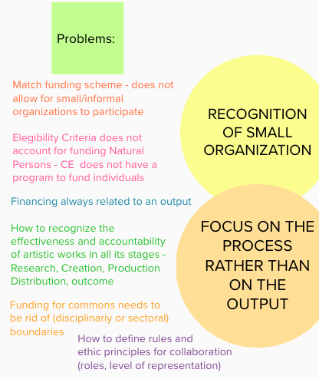
1.1 What concrete solutions to make EU policies and grants more accessible for commons and alternative cultural spaces? How can we establish methodologies and about who is legitimised “to speak on behalf of the sector” for a participatory cultural policy–making and grant co-creation together with the EU level?
Due to its nature, this community is facing many issues...
Based on the mentioned research, L’Asilo’s and our own experiences, we witnessed a few ‘problems’ for cultural, creative & commons spaces to enjoy funding by the EU.
This problems are particularly for:
- small organizations
- informal organizations
- commons initiatives
- individuals

Slide 6
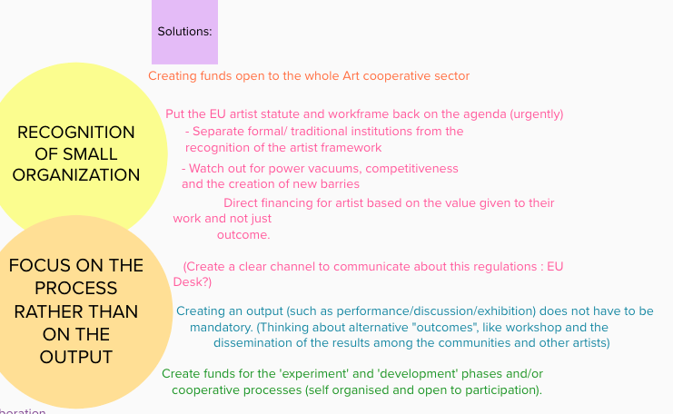
So we decided to make an imaginary exercise addressing some solutions….

Slide 7
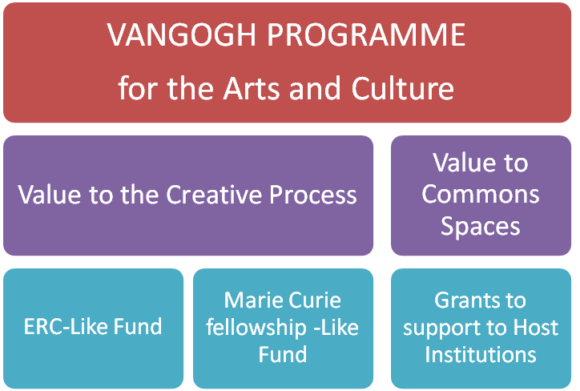
… et Voilà!!!!!
We have imagined the European Grant and Fund VAN GOGH PROGRAMME...
-

Slide 8
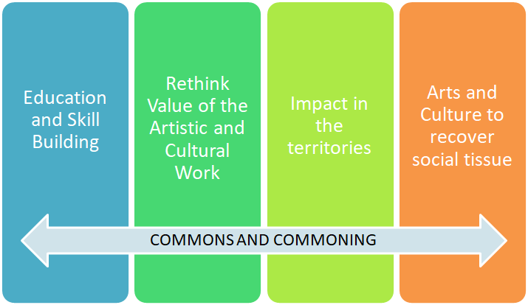
Priority Areas for the allocation of Funding

Slide 9
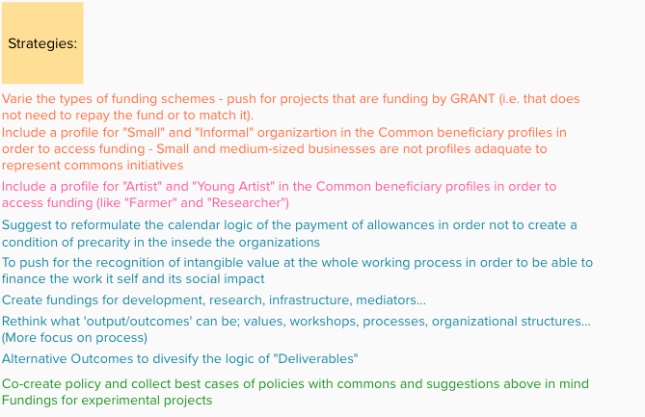
Here you find a few possible strategies to realize the solutions for the problems we’ve located.

Slide 10
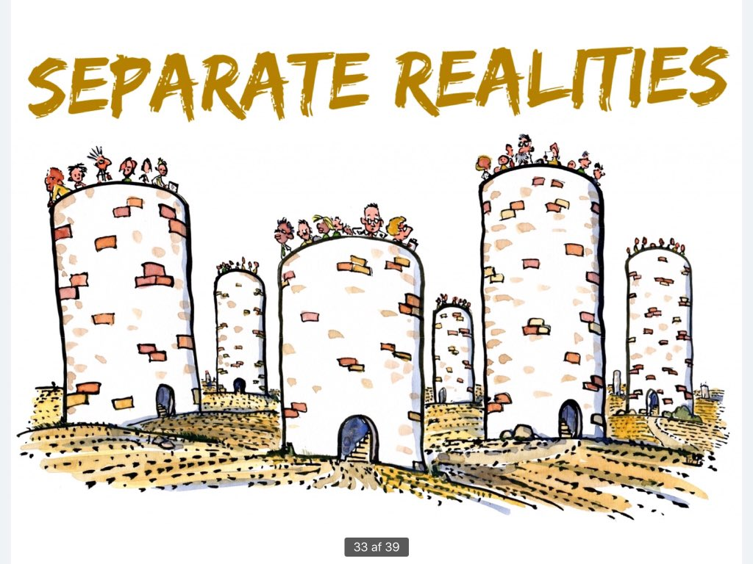
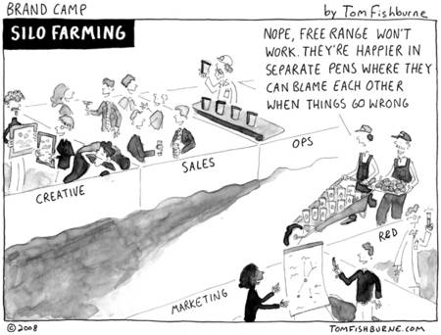
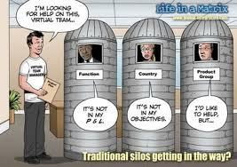
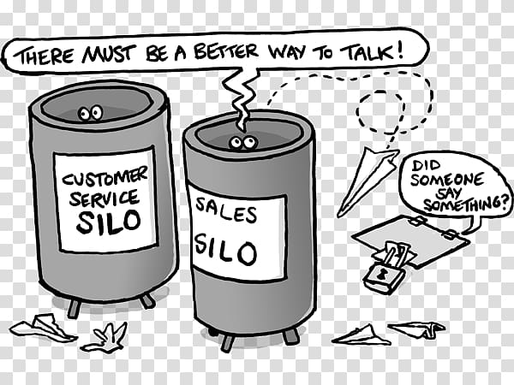
1. 2 How can cultural policies and grants activate new commons-based ecosystems that promote a sustainable creative work (i.e. allowing space and time for research and production, peer learning, income, and relationship with society)?

Slide 11
1. 2 How can cultural policies and grants activate new commons-based ecosystems that promote a sustainable creative work (i.e. allowing space and time for research and production, peer learning, income, and relationship with society)?
Commons (spaces) are particular and ask for new forms of (policy and) funding, that takes in account their search for new ways of organizing ourselves to enforce the local fabric, based on values such as autonomy, self-organization, new ethical principles, collaboration and so on. These grants and fundings keep an eye out for and looks for ways to support the organic and experimental character of how commons create new organizational structures; the start-up phase, the transversal reach and so on. Only in such a way commons can become self-run ecosystems for the co-imagination and co-creation of new social conditions.
In this perspective, at EU level, it is worth rethinking the channel of financement (no interest loans) and the subjects to be financed.

Slide 12
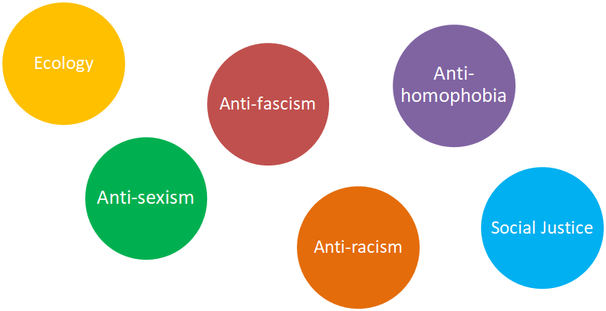
Rules and ethical principles for collaboration within the commons

Slide 13
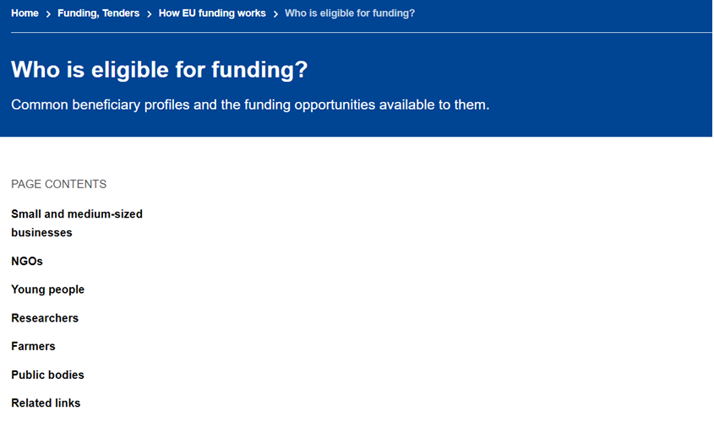
1. 2 How can cultural policies and grants activate new commons-based ecosystems that promote a sustainable creative work (i.e. allowing space and time for research and production, peer learning, income, and relationship with society)?
Allow natural person funding mechanism → recognising the importance of the creative process rather than focusing only on the output (See also 1.1)
Let´s create the Artist Beneficiary Profile!!!!

Slide 14
1.3 How can cultural and creative work be made more sustainable, in particular linked to/ after Covid-19, as well as from a green perspective: going beyond the logic of ‘big events’ and hypermobility?
Despite their rhetoric, big events are conceived in a short-term perspective since the investments mostly call for strategies of development based on tourist attractiveness
Big events
In EU logic (CE), most part of resources goes to mobility.
The paradox: mobility is financed while the labour of artists is not!
Hypermobility
Covid-19
The pandemic situation has exacerbated the problems already existing (working condition in cultural sector) and made more complicated international mobility
What do we need?
→ Actions that promote the sustainability of the cultural and creative sector
→ Overturning the rhetoric of big events, fostering small interventions and cooperation with local actors
→ Recognising the care value of artists for society

Slide 15
1.3 How can cultural and creative work be made more sustainable, in particular linked to/ after Covid-19, as well as from a green perspective: going beyond the logic of ‘big events’ and hypermobility?
By creating fundings for commons our society becomes more sustainable and regenerative (with the contemporary crises in mind) because: - these funds support long-term solutions since commons adopt long term perspectives
- we can find more flexible and reflexive ways of organising ourselves - commons (re)enforce the local fabric - it is an answer the problems caused by privatization - it facilitates solidarity, a sense of citizenship, mutual understanding… - enable new roles for or amplify today's role of art (as a creator of safe, as a catalysator of open innovation, yet antagonistic spaces) - it creates a fertile ground for more rebellious, critic & autonomous projects (for example - of minority groups - to fight inequalities) - to experiment new forms of (local and global) participation, inclusiveness, freeness, open source and transparent organizing, etc.

Slide 16
Our 5 Keywords
Challenge Nr 1: The commons as ecosystems for culture after Covid-19
Commons-based Society
Renew social tissue
Reclaiming Rights
Democratize Funding
Re-Value Artistic and Cultural Work

Slide 17
Through multi-sector, multi-practice dialogue, we can achieve equity and sustainability by being hyper inclusive of voices stemming from marginalized artistic and cultural practices and communities, especially in this moment. Encouraging collaboration amongst actors in both the micro and macro spaces within the sector.
Terminology: We must also use more inclusive, accessible and equitable language in both the creation of such schemes and the application process itself . The notion of “legitimizing” voices is one that is particularly elitist. Shift from utilizing the term “legitimizing” and associated exclusionary practices to a more participatory, holistic structure that values a wide range of voices.
Analyze the systems and policy making mechanisms in which the sector currently employs, and offer open-ended, sustained support to those who come from under resourced populations and cultural spaces as well as evoke radical imagination in developing new pathways in democratizing the cultural sectors and the process of participatory cultural-policy making..
How can we establish methodologies and about who is legitimised “to speak on behalf of the sector” for a participatory cultural policy–making and grant co-creation together with the EU level?

