Slide 1
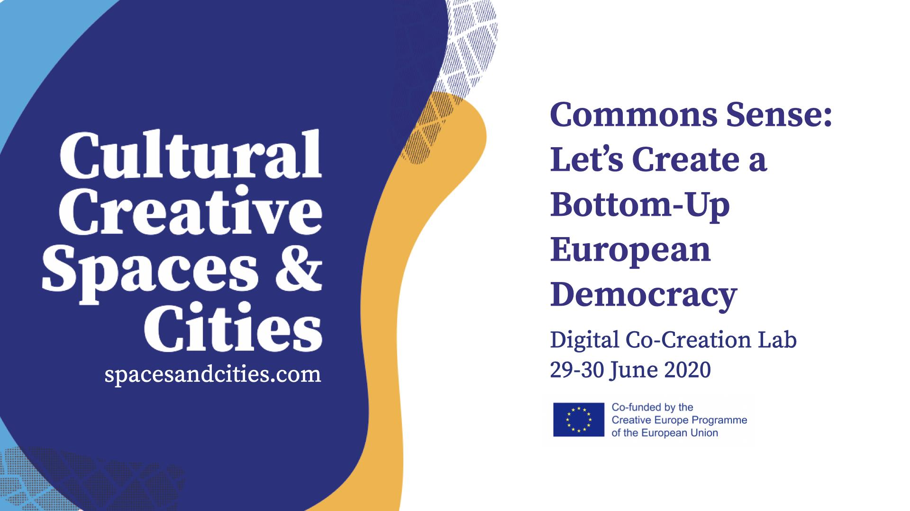

Slide 2
Co-Creation Lab Proposal
Challenge Nr 1: The commons as ecosystems for culture after Covid-19
Team:
Plotforming Bakers
Names of team members:
Matina Magkou
Codruța Simionescu
Julia Gouin
Uta MuttAtom
Julien Gastelo

Slide 3
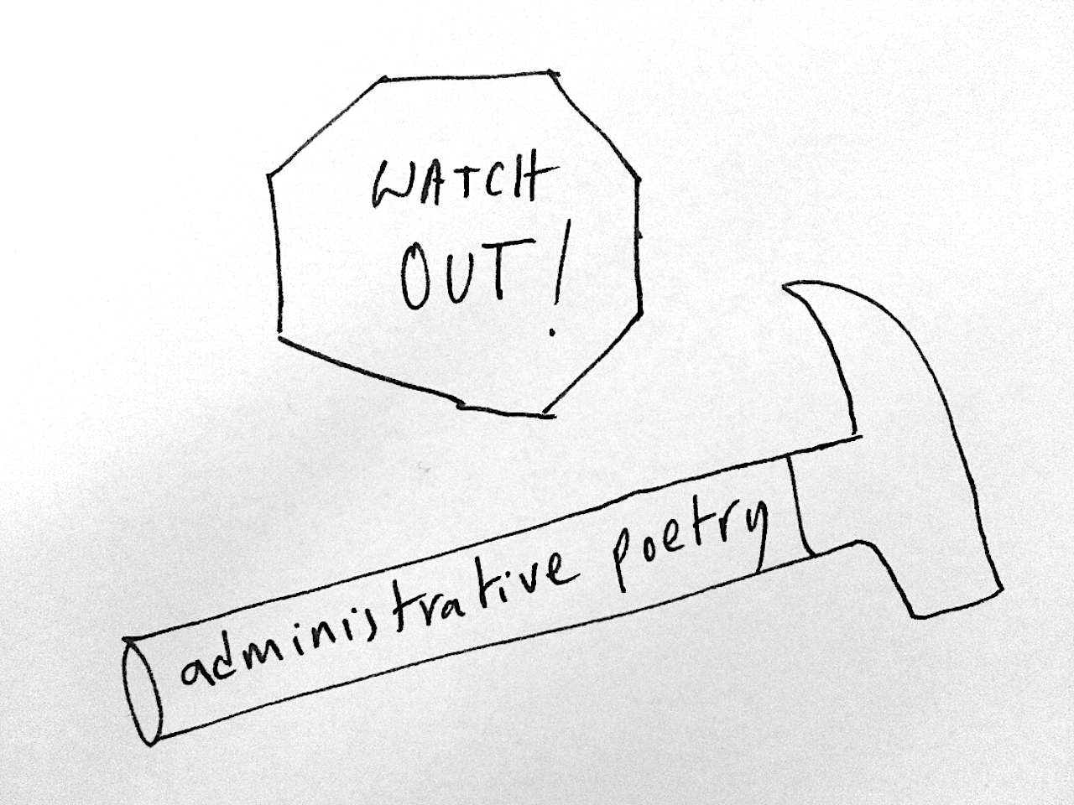
1.1 What concrete solutions to make EU policies and grants more accessible for commons and alternative cultural spaces? How can we establish methodologies and about who is legitimised “to speak on behalf of the sector” for a participatory cultural policy–making and grant co-creation together with the EU level?
Analysis
Too much bureaucracy and "administration poetry"
Mutual lack of trust between policy makers and the sector
Exhaustion and lack of resources to respond to EU grants
Dependency on a grants’ logic
Blocking local initiatives
Excess of information but lack of transparency and vision

Slide 4
1.1 What concrete solutions to make EU policies and grants more accessible for commons and alternative cultural spaces? How can we establish methodologies and about who is legitimised “to speak on behalf of the sector” for a participatory cultural policy–making and grant co-creation together with the EU level?
Solutions proposed
- Rise the budget for culture
- Ease of the administrative process by simplified application processes
- Enabling small organisations to benefit from grants
- Make announcements clearer
- More trust and appreciation of methods versus outcomes (inclusivity, sustainability, charter of core values, awareness of discriminatory processes, etc.)
- Ensure accessibility to people outside EU through international cooperation programs: pre-accession countries or as part of international agreements
- Empower legitimate intermediary actors from the cultural sector
- Introduce a new type of grant addressing specifically commons rooted initiatives and the arts

Slide 5
1.1 What concrete solutions to make EU policies and grants more accessible for commons and alternative cultural spaces? How can we establish methodologies and about who is legitimised “to speak on behalf of the sector” for a participatory cultural policy–making and grant co-creation together with the EU level?
Solutions proposed part 2
- Networks like TEH, municipalities, NGOs should be consulted in order to check if criteria are met instead of asking the artists and grass root activists to write hundreds of pages of administrative poetry for fund-raising
- Local governments should be informed that there can be more cultural funding, if the creation of commons is being encouraged (meaning industrial friches, made legally accessible to the population, transformed into a common, can generate EU-sponsored local cultural benefit in a relatively short term)
- Creation of a digital platform managed by representatives of DG EAC + MEPs and an elected board (cultural sector actors elected by the European Parliament)

Slide 6
1. 2 How can cultural policies and grants activate new commons-based ecosystems that promote a sustainable creative work (i.e. allowing space and time for research and production, peer learning, income, and relationship with society)?
Analysis
- Precarity in the cultural and activist sector
- Disparity within the EU regarding social benefits and a need for efficient decision-making in EU on social policy
- Cultural organizations being used as social service providers diverting them from their initial projects
- According to the Status of Artists in Europe, "artists and their activities are increasingly seen as entrepreneurs/entrepreneurial which contribute to economic development, their working practices and motivations must nevertheless be considered "atypical" in different ways“ (atypical financing)
- Sustainability in terms of funding should mean that you can count on a regular income that enables you to develop. Sustainable means working in secure conditions and without fear
- Grants should be on long-term basis and not on a project-basis
- As with Covid-19, we are facing a huge economic crisis, expecting a tremendous rise of unemployment, a further precarisation of work and sinking wages, we should argue that developing commons is an answer to this (or any other systemic) crisis: creating jobs, creating dignity, rethinking our ways of living, working and creating together.

Slide 7
1. 2 How can cultural policies and grants activate new commons-based ecosystems that promote a sustainable creative work (i.e. allowing space and time for research and production, peer learning, income, and relationship with society)?
Solutions proposed
- Europeanization of the French “l’intermittents du spectacle” model or the Belgian system of the artist status and extension to all actors from the cultural sector
- Grants for functioning on the long run before grants to add new projects
- Community funds, where the allocation of funds is decided in a collective way
- Re- purposing of existing financial infrastructures
- Developing awareness tools for artists in terms of assuming their status
- Creating a platform with the status of the artist on the labor market in different EU countries,
fiscal obligations. -> tax union/ social union (but certainly a different discussion: rebuilding the EU)
- Increase lobby activities for ensure the social protection of artists
- Advocacy to change perception of public authorities regarding the work of artists as a positive expense

Slide 8
1. 2 How can cultural policies and grants activate new commons-based ecosystems that promote a sustainable creative work (i.e. allowing space and time for research and production, peer learning, income, and relationship with society)?
Solutions proposed
- Public-private partnerships, CSR
- “Social impact" (qualifications like numbers of visitors, numbers of clicks on social networks etc) mustn't be a criteria for funding. We need alternative narratives to social impact, based also on a values approach
- New grant schemes are needed dedicated to experimentation/ learning by failing
- New grant schemes open to collectives/ not necessarily established organisations for research and development
- More systems and opportunities for peer advice. Peer selection processes need to be introduced in funding programmes.

Slide 9
1.3 How can cultural and creative work be made more sustainable, in particular linked to/ after Covid-19, as well as from a green perspective: going beyond the logic of ‘big events’ and hypermobility?
Analysis
- Difficulty accessing buildings by commons and arts communities
- Issues relating to real estate and capital
- Threat that cultural spaces are being used for gentrification purposes

Slide 10
1.3 How can cultural and creative work be made more sustainable, in particular linked to/ after Covid-19, as well as from a green perspective: going beyond the logic of ‘big events’ and hypermobility?
Solutions proposed
- Enable local organizations to gain access to facilities on the long-run
- “We want the bakery, not the piece of cake!” We need to ensure access to resources put in commons rather than distributing pocket money (such as with the Universal Basic Income project which is and individualist answer to a collective issue)
- Make cultural centers/creative spaces financially sustainable
- Associate other sectors to arts and commons missions and projects: social, business, health, etc.
- Strengthen collaboration with policy makers at local level
- Support programmes encouraging the use of empty spaces in collaboration with the municipality- paying attention to gentrification processes

Slide 11
1.3 How can cultural and creative work be made more sustainable, in particular linked to/ after Covid-19, as well as from a green perspective: going beyond the logic of ‘big events’ and hypermobility?
Solutions proposed
- Cultural spaces should not function as services providers for cultural policies. They should be given the space to experiment and work with communities.
- Solidarity among cultural spaces. They should find ways to interact/ cooperate/ share resources- locally and internationally.
- Reflection is needed on the non-physical dimension of the cultural spaces and complementarity of digital and physical space
- New realities imposed by social distancing mean that more space is needed, especially open air and public space.

Slide 12
References
Michel Simonot, La langue retournée de la culture, éditions excès, 2017
Aude Vidal, Le revenue guarantie, 2020, éditions du monde à l'enver : http://www.lemondealenvers.lautre.net/livres/revenu_garanti.html the author articulates the limits of the UBI as an individual solution to a collective problem.
Michel Bauwens and Vasilis Niaros, Changing Societies through Urban Commons Transition, https://commonstransition.org/wp-content/uploads/2017/12/Bauwens-Niaros-Urban-Commons-Transitions.pdf
THE STATUS OF ARTISTS IN EUROPE, Policy Department for Structural and Cohesion Policies – Post A: Culture and Education Sector, https://www.europarl.europa.eu/RegData/etudes/etudes/join/2006/375321/IPOL-CULT_ET(2006)375321_EN.pdf
Debate on more efficient decision-making in EU social policy, https://ec.europa.eu/social/main.jsp?langId=en&catId=849&furtherNews=yes&newsId=9351
On the practice of small art organizations, scale, rights for in definition and "a matter of platforming" and "interpretative communities" :
https://www.youtube.com/watch?v=Zfs-yQqvlA4
https://www.youtube.com/watch?v=qJwEks1dFaI conference https://www.commonpractice.org.uk/
-

Slide 13
Our 5 Keywords
Challenge Nr 1: The commons as ecosystems for culture after Covid-19
SWANZE (dialect from Brussels meaning facing tragic situations with humor)
SUSTAINABILITY
TRUST
SOLIDARITY
SANTA POLENTA!

