Slide 1
Commons Sense: Let’s Create a Bottom-Up
European Democracy
Digital Co-Creation Lab
29-30 June 2020
spacesandcities.com

Slide 2
Co-Creation Lab Proposal
Challenge Nr 3: Building spaces of encounter between local and EU level
Team:
6 - Glocal Spaces
Names of team members:
Jeroen Barendse, Viola Bernacchi, Mette Slot Johnsen, Cecilia Iaconelli, Marije Nie, Zane Estere Gruntmane

Slide 3
3.1 Organisation of the ‘homes of commons’
Top-down organisation from one to many
The EU has been investing several resources in explaining their policies and purposes, although these activities have focused mostly on the most administrative and technocratic aspects of living in Europe. At large, the EU has been operating through a top-down framework that marginalises the importance of being part of a public sphere.
This current framework has revealed its fallacies: EU identity in crisis; multilingualism; bad journalism; populism and persistence of stereotypes which challenge the social, economic and political cooperation of state members.
Local authorities and cultural operators are key figures to reverse the current framework and open a bottom-up dialogue between EU citizens and its institutions. In this conversational approach, we envision a space which speaks, with a polyphonic voice, to different actors: Going from one to many, to many to one.
Pan level
National level
Regional level
Local level
Bottom-up organisation from many to one : one polyphonic voice
Local level
Regional level
National level
Pan level

Slide 4
3.1 Organisation of the ‘homes of commons’
Our hybrid (on- and offline) platform identifies the European commons through creatives practices and stories. The local initiatives are a bridge between creative communities and citizens. This hybrid platform is a space of encounters — online with the digital platform, offline with interventions, events, installations, connecting local with global, building and shaping Glocal in motion, and together is creating intertwining hybrid spaces that connect both.
The hybrid aspect of the platform allows information/ collaboration to reach a capillary of all the stakeholders, by sharing a joint polyphonic message.
By defining a network of partners (starting with the urban labs and other commons or umbrella organisations), we can establish connections and identify facilitators who can coordinate the network and output, and report to EU institutions. Our aim is to create a space for collaboration, and as a team to search out and brainstorm possible contents based on the platform manifesto guidelines.

Slide 5
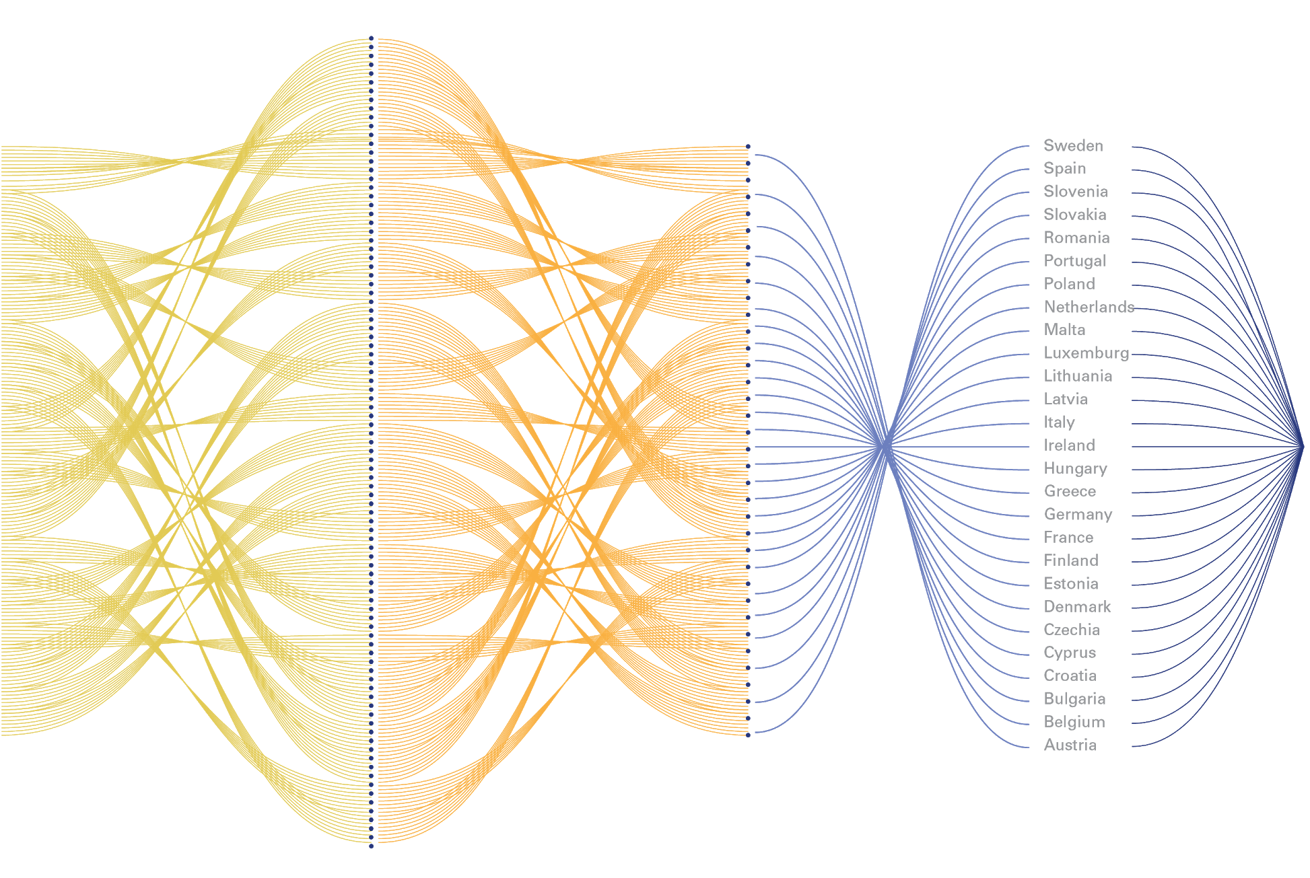
Visual concept
Collaborative process:
Local and regional authorities as a bridge between creative communities, EU institution and all citizens
Hybrid platform as ‘Homes of commons’
Creative communities + initiative
EU
Institutions
Regional authorities
National authorities
Local authorities
All citizens as one larger audience

Slide 6
3. 2 Agenda of the homes of commons
Every story and every person’s’ micro narrative is a thread in the interweaving of contemporary culture in all its diversity and complexity. How can we share these stories to open up windows to each other's lives?
We need to not only share stories, but also active practices, which help us to live, create and work together. Technologies for living together open possibilities to new and necessary practices which will surface in the hybrid space: How to enable ourselves to work together in a creative way that does operate more than share information. We eager to discover how to make this space fertile and generative.
Creating an archive / history of European stories and culture, that invites citizens to make personal journeys of discovery. To find unexpected connections and ‘family of the mind’ inside the archive, and answer to issues of history and cultural / personal identity in a European way. Furthermore, showing the richness of diversity and polyphony of our own. It gives an alternative to the answer of nationalism and fascism. Tension: how to make people enthusiastic? How to enable this ‘drifting and exploring”? Possibly: Is there a way to save your search and share the results?
Deconstruct stereotypes
Capturing the complexity of reality, even the gray areas (brights and shadows)
Sharing multifaceted narratives of the European cultural community, which allow to effectively build up a European Glocal landmark.

Slide 7
3. 2 Agenda of the homes of commons
Homes of commons will naturally have their own agendas and a particular interest in their day to day activities. However, the basic, shared goals should be to strengthen a common sector, which in itself can be a leveller in a more equal society and work as a force for change. In order to do so, homes of commons should collaborate and support peer groups across local, regional, national and international levels. The main function should be to further cooperation by encouraging and strengthening collaboration and multilingualism.
Engaging local participation is integral to the intention of the commons, but the way it is applied will vary depending on need.
So determining whether the focus should be advocacy/ information/ co-creation etc seems pre-emptive, as collaboration can cover all of the above and at the best of times a project or creative output encapsulates several intentions.

Slide 8
Visual concept
Simplified mind-map of actors and functions

Slide 9
3.3 Homes of commons and cultural and creative spaces
We live in a time of friction and rising nationalist tendencies, brought on by many factors, all accelerated by the pandemic and its economic consequences. Awareness goes two ways: in order to be aware of the importance of organisations and institutions sometimes we must be made aware.
We envision a platform which transforms through time and context and allows its users and audience to listen to each other. Within this framework and intentions we are interested in investigating the proposal :
Open, inclusive and welcoming community
Clearly and broadly communicated contents, in an easily accessible language and format
Exploration of new synergies between physical and virtual space
Can the platform become a tool in itself?

Slide 10
3.3 Homes of commons and cultural and creative spaces
To facilitate the links between EU and the local level, we intend to track all the existing local authorities and organisations that are active in the creative fields. This preliminary research will help to define a capillary network of actors from all EU state members. The hybrid platform will be proposed to this network as a pilot project for sharing stories and practices of contemporary culture in all its diversity Utilising networks of existing commons and flat structure organisations to create a hybrid space, both on and off line, it’s possible to reach and engage under-the-radar niche creative initiatives, communities, small towns, remote regions; who may feel disconnected, disaffected and disinterested in the bureaucracy of the EU. To enable the broadest participation visibility must be high and communication must be clear, straight forward and inclusive both in it’s wording, presentation, and formats available.
Access to hybrid/ online spaces can be hindered by lack of infrastructure; whether in the way of roads and public transport to regional hubs, or in internet/ phone connectivity and even electricity. These needs must be addressed, making this both an online and a very physical possible roaming presence, however possible.
It’s crucial for the EU to support commons as a viable alternative to create a more equal and sustainable society, especially for the many people who live and work precariously due to the nature of their industries. The EU must widen the scope and overview of culture across Europe and send a joint message that everyone matters in rebuilding/ restructuring societies post COVID19.

Slide 11
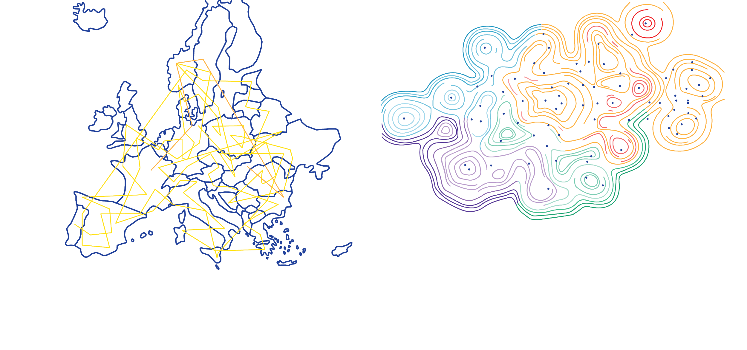
Visual concept
1 point = 1 story/practice
Impression of the “Evolving archive of commons”: map-like visualisation where the location of each point is based on content similarity. The proximity of the points goes beyond geographic borders and different languages.
Enabling and visualising the existing network of local authorities and creative initiatives, from Urban Labs to many others.

Slide 12
Our 5 Keywords
Stories/practices in motion
Being present
Polyphonic space
Activating networks
Curiosity

