Slide 1
Commons Sense: Let’s Create a Bottom-Up
European Democracy
Digital Co-Creation Lab
29-30 June 2020
spacesandcities.com

Slide 2
Co-Creation Lab Proposal
Challenge Nr 3: Building spaces of encounter between local and EU level
Team:
Team 13 - the European Stargate team
Bart Grugeon. Brussels. Belgium
Ilie Rădoi. Timișoara, România
Kathrine Richter. Copenhagen, Denmark
Asli Samadova. Milan, Italy / Baku, Azerbaijan

Slide 3
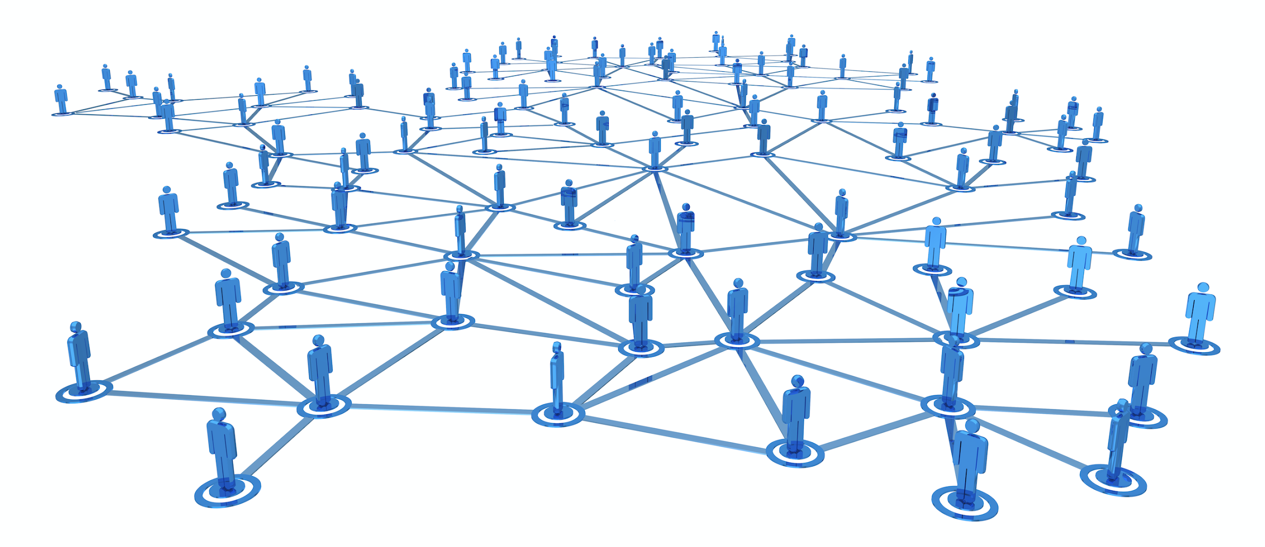
Homes of Commons should be Europe’s Stargate - a people-driven network with organisational, financial and social resources

Slide 4
3.1 Concrete proposals to bring Europe closer to citizens and cultural operators – Organisation of the ‘homes of commons’: how can homes of commons act as effective tools to decentralise EU institutions and foster a dialogue with the local contexts? How can homes of commons communicate and collaborate simultaneously with EU institutions, local authorities and citizens?
We want to empower citizens and invite them to engage with the EU institutions. This is achievable through locally anchored Homes of Commons that act as a local gateway of ideas. As citizens bring their ideas into an interconnected Homes of Commons they shall expect dedicated assistance and be able to connect with best practices across borders. Such a process can take citizen ideas to the next level by connecting them with like-minded citizens and achieve societal development through dialogue and commitment. *Inspired by Democracy Festivals

Slide 5
3.1 Concrete proposals to bring Europe closer to citizens and cultural operators – Organisation of the ‘homes of commons’: how can homes of commons act as effective tools to decentralise EU institutions and foster a dialogue with the local contexts? How can homes of commons communicate and collaborate simultaneously with EU institutions, local authorities and citizens?
We want to establish locally anchored, physical and digital, mobile and diversely targeting shared spaces where Pan European ideas and initiatives can be developed locally and then gain support from other like-minded people in Europe and beyond. Establishing mobile Project Offices will motivate citizens wherever they are to take their ideas forward. This will generate local voices and in exchange, EU institutions must develop tools to incorporate them. *Inspired by ContainerCities like CPHVillage in Copenhagen and Ta(r)dino 6 Art Platform’s Micro-commissions in Azerbaijan and AWI in Italy
Notes:
Link to CPHVillage - https://cphvillage.com/

Slide 6
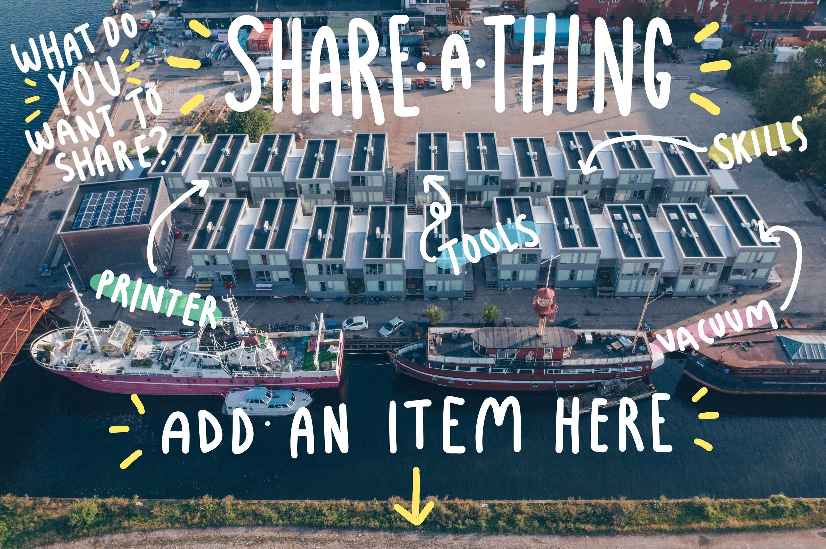
Image: CPHVillage
Notes:
Source: https://cphvillage.com/share-things

Slide 7
3. 2 Concrete proposals to bring Europe closer to citizens and cultural operators – Agenda of the homes of commons: what should be on the agenda of homes of commons, in order to facilitate the links between the EU and the local level? What function should homes of commons have (advocacy, information, co-creation, local participation…)?
Homes of Commons should stimulate new dialogue and become the platform through which problems that are felt by citizens and exist in society can be addressed through empowerment, network and support. This will empower citizens to view themselves as important actors in society and should start locally, personally. Over time, this will realise an organic structure that can connect a continent of local actors, stakeholders and open up a European dimension to boost activism and advocacy in local communities in the EU and in the EU Neighbourhood states.
Notes:
might wish to put the 3 points into 1 slide at the beginning as otherwise the slides are too heavy with the text

Slide 8
3. 2 Concrete proposals to bring Europe closer to citizens and cultural operators – Agenda of the homes of commons: what should be on the agenda of homes of commons, in order to facilitate the links between the EU and the local level? What function should homes of commons have (advocacy, information, co-creation, local participation…)?
Homes of Commons as a European Stargate, a gateway that connect citizens working on the same or similar challenges, connect resources (organisational, financial, people-driven) and enable citizens to be active drivers in local, regional and societal change. Imagine a physical portal for citizens - not at central level, but locally anchored and connected with all of Europe. Europe is diverse so situations are different and Homes of Commons must address issues where they exist and use the tools wherever they are found.
*Inspired by Ambasada in Timișoara, Romania
Notes:
Link - https://www.plai.ro/ambasada/

Slide 9
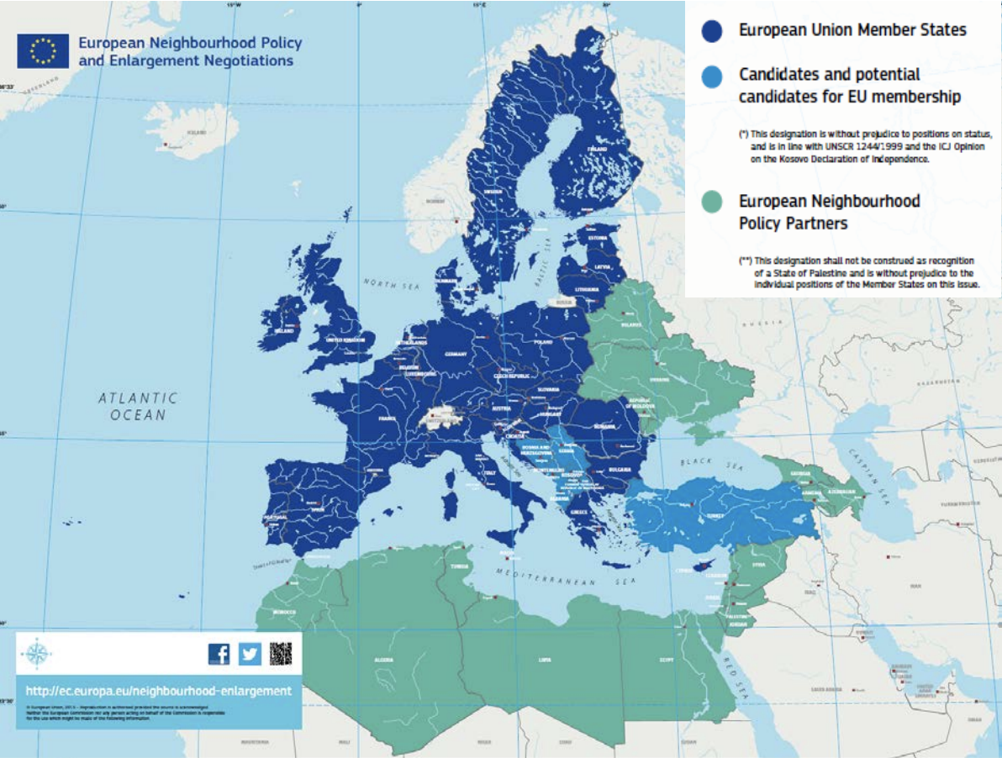
Image source: European Investment Bank Group, 2018 report

Slide 10
3.3 Homes of commons and cultural and creative spaces: how can we rethink cultural and creative spaces as community organisations suggesting new ways for the EU to relate with the local level, aware of the role of relevant national/regional level organisations ?
We need Homes of Commons because many EU projects lack true interaction at a local, grass-root level. EU-projects remain unknown and some are completely inaccessible to regular citizens. This results in lack of a dialogue and no sense of direct benefits to the local communities, resulting in citizens having little understanding of the EU, its institutions and European values. The EU must be made accessible to citizens - not through applications or programs alone, but through activities and direct invitations to engage.

Slide 11
3.3 Homes of commons and cultural and creative spaces: how can we rethink cultural and creative spaces as community organisations suggesting new ways for the EU to relate with the local level, aware of the role of relevant national/regional level organisations ?
The Homes of Commons as a European Stargate can revolutionise the way citizens re-apply community organising skills in new constellations to improve society. Applying fundamental European values across the Homes of Commons will further encourage and promote European value-based community organising regardless of local, regional or national context. By challenging the concept of the EU as an economic project, we can boost the transition towards a circular economy which is the re-application of resources. Citizen resources in community organising should be boosted! Proclaiming 9 May as a Europeans Day would be a significant shift towards a truly citizen-driven union - not just an institutional one. *Inspired by Kate Raworths donut economic theory

Slide 12
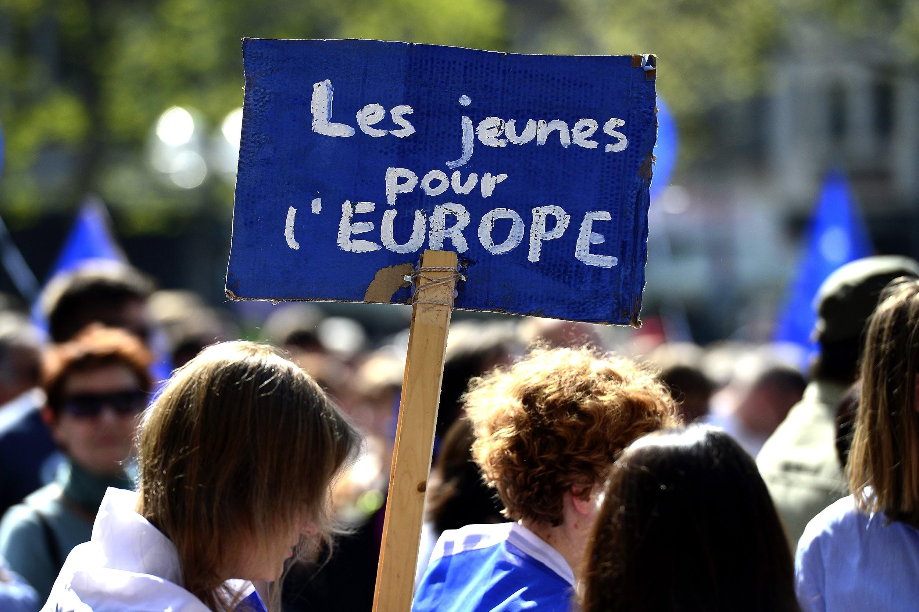
A pro-European Union rally titled 'Pulse of Europe' at the Roncalliplatz square in Cologne, Germany, 09 April 2017. The citizen's initiative was founded to encourage EU citizens to promote a 'pan-European' identity.
Image: neweurope.eu

Slide 13
Our 5 Keywords
Challenge Nr 3: Building spaces of encounter
between local and EU level
Network
Empowerment
Dialogue
Commitment
Stargate
Image: @StargateNow_EU Twitter account, an EU branch of Fans of the Stargate television franchise

