Slide 1
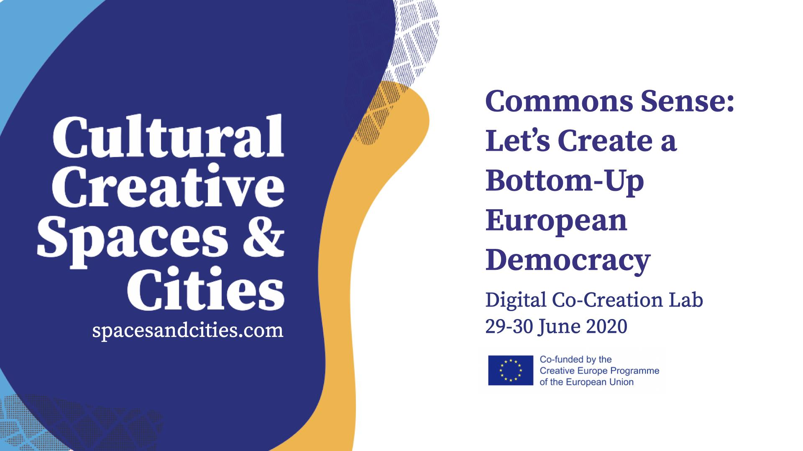

Slide 2
Commons Sense: Let’s Create a Bottom-Up
European Democracy
Digital Co-Creation Lab
29-30 June 2020
spacesandcities.com

Slide 3
Proposal Submission Instructions
Dear team,
please use this format to deliver your proposal. We ask you to provide an analysis and a concrete proposal for each of the subtopics of the challenge you chose to focus on. Finally, we ask you to write 5 keywords for each subtopic (slide 12). If you think that one or more of the subtopics is not relevant, you can provide an alternative solution (and keywords) to the challenge, giving a reason why you deem the original subtopic not relevant.
Any doubts?
Check the guidelines!

Slide 4
Co-Creation Lab Proposal
Challenge Nr 1: The commons as ecosystems for culture after Covid-19
Team:
Team 4
Names of team members:
Alice Borchi, Rafael Bresciani, Marije Nie, Michael Dobbie, Jules Desgoutte

Slide 5
1.1 What concrete solutions to make EU policies and grants more accessible for commons and alternative cultural spaces? How can we establish methodologies and about who is legitimised “to speak on behalf of the sector” for a participatory cultural policy–making and grant co-creation together with the EU level?
We need a definition of the commons that is not only an academic instrument, but rather the foundation of an European-level policy that can recognize and legitimise the existence of multiple commons around Europe, give them an official legal status and enable them to get funding more regularly. This is a delicate and nuanced issue that cannot be resolved quickly and that needs deep legal, philosophical and political reflections, and needs the involvement of many different areas of policy.
These spaces must be inspirational as another way to practice citizenship. Where people gather for innumerable reasons/goals, involved in different activities always mediated by the artistic practice. Here the shaman metaphor works best because the artistic practice becomes the medium from which all the people involved will create new experiences for everyone. So, the space should be constantly active, occupied. By permanent residents with work space and some collective space for practices between peers.
For what concerns the sphere of cultural policy, some key principles should be:
The cultural rights of people in Europe;
Cultural democracy;
The creation of hybrid spaces of encounter (both physically and digitally);
Long term sustainability of practice, organizations, engagement in community, research and exchanges (minimizing waste of skills and resources) and the artistic outputs that are part of these processes.

Slide 6
1.1 What concrete solutions to make EU policies and grants more accessible for commons and alternative cultural spaces? How can we establish methodologies and about who is legitimised “to speak on behalf of the sector” for a participatory cultural policy–making and grant co-creation together with the EU level?
In order to ensure legal consistency across different actors around Europe, a policy framework on the recognition of the commons should be produced. This should provide definitions, legal rights and flexibility of adoption to fit the needs of different organizations.
Guiding principles:
No culture without democracy, no democracy without culture
Accessibility on a regular basis - dismantling fetishes of the cultural world (excellence, numbers, fame, genius, etc)

Slide 7
1.1 What concrete solutions to make EU policies and grants more accessible for commons and alternative cultural spaces? How can we establish methodologies and about who is legitimised “to speak on behalf of the sector” for a participatory cultural policy–making and grant co-creation together with the EU level?
What are the commons?
A commons is a place which ensures the right of citizens where they can create their own cultural opportunities, and practice exchange and reflection.
The commons, culture and democracy
Culture as the product of social and political experimentation and the output of interaction.
The arts are the place where you can distance yourself from your own story and understand other perspectives and reflect on universal themes. Culture is vital for democracy, and culture cannot thrive without democracy. In this we found that the embodied and artistic practices are key elements for practicing values necessary for citizenship.
Getting out of your own story through art
Getting into body through movement
Connecting, opening, sharing a (creation) process together
Finding the creative space in-between where the unknown lives

Slide 8
1. 2 How can cultural policies and grants activate new commons-based ecosystems that promote a sustainable creative work (i.e. allowing space and time for research and production, peer learning, income, and relationship with society)?
Alternative spaces and cultural commons in Europe represent a fragmented universe with different resources, skills, strengths and knowledge. This proposal does not want to ‘unify’ these realities under the same set of rules and constraints, but rather celebrate their uniqueness and their embeddedness in their own community. The commons can be a powerful place for shifting the fragmentation and isolation that many of us experience in our professional ánd private lives into a source of power, transformation and growth.
Because of isolation / separation we can make connections
Because of fragmentation we can change and grow, and relate to many different voices.

Slide 9
1. 2 How can cultural policies and grants activate new commons-based ecosystems that promote a sustainable creative work (i.e. allowing space and time for research and production, peer learning, income, and relationship with society)?
Grant-making for the cultural commons should not not:
Foster competition for limited resources;
Encourage artists to continuously produce new material;
Alienate local communities;
Foster the isolation of artists and organizations (because of competition, lack of networks, lack of spaces to discuss, get feedback etc);
Base all assessment of projects on outputs
Foster fetish around excellence, ‘genius’, cult of personality.

Slide 10
1. 2 How can cultural policies and grants activate new commons-based ecosystems that promote a sustainable creative work (i.e. allowing space and time for research and production, peer learning, income, and relationship with society)?
Grant-making for the cultural commons, instead, should:
Foster commoning, sharing skills and resources, the creation of an international cultural milieu of artists who would otherwise be isolated.
Acknowledge and celebrate the existing work of artists and enable them to make the most of their current practice, without the pressure of continuously “putting out” new material to respond to specific calls, grants etc., preventing artists from “wasting” their creations after a short period;
Facilitate the relationship between local communities and artists/organizations, beyond the immediate remit of spaces/people (e.g. creative use of organizations’ spaces that are available to the local community);
Enable long-term sustainable networks beyond conferences/big events creating multiple “spaces of encounter”; (hybrid physical/digital)
Create forms of assessment that better fit the purpose of the cultural commons, focusing on process, rather than output, and assessing “density” of practice and engagement.
Fund people and work, not buildings.

Slide 11
1.3 How can cultural and creative work be made more sustainable, in particular linked to/ after Covid-19, as well as from a green perspective: going beyond the logic of ‘big events’ and hypermobility?
The established logic of results and perfection is insufficient. It privileges a small number of people whether the vast majority stays a side of the opportunities and the spotlight. These Spaces of Encounters must be the materialisation of a critique viewpoint of this concept, fostering imperfection, uniqueness, fragmentation and valuing differences. So, these spaces shall look for initiatives that bring consistency, fluxes, becoming a better environment for the society that embraces each SoE.
We shall be measuring the exchange, the spontaneous relationships, the independency of initiatives. It shall try to be an endless cycle of infinite feedbacks, to follow a non linear narrative, to stimulate cycles of different length and dimensions.
And it can’t be isolated in the local reality. As a EU wide network, exchange between peers must be encouraged. We must propose a liquid structure based in core values of horizontality, instability, exchange and communication. Practices can move from one place to the other, people can be embraced by this dynamic, autonomy is a central value, but also is cooperation and communication.
In the end we will be putting value on the path. The path is common. The process of infinite change. Being in movement, bringing new people, new ideas, new practices. Not standing in the same place. These are the values that we want to foster.

Slide 12
1.3 How can cultural and creative work be made more sustainable, in particular linked to/ after Covid-19, as well as from a green perspective: going beyond the logic of ‘big events’ and hypermobility?
So, what should we fund?
Digital resources (archives, repositories of professional profiles and maybe contacts, platforms for digital co-creation, online material accessible to the public)
Governance resources (funding to give money to key people to organize and maintain processes)
Artistic and non-artistic labour
Public engagement resources (funding to collaborate with schools and engaging children and teens; maybe exchanges between different communities of children?)
Physical resources (NO NEW BUILDINGS but funds to make the most of existing spaces)
Knowledge exchange processes (mobility grants, digital resources, etc)

Slide 13
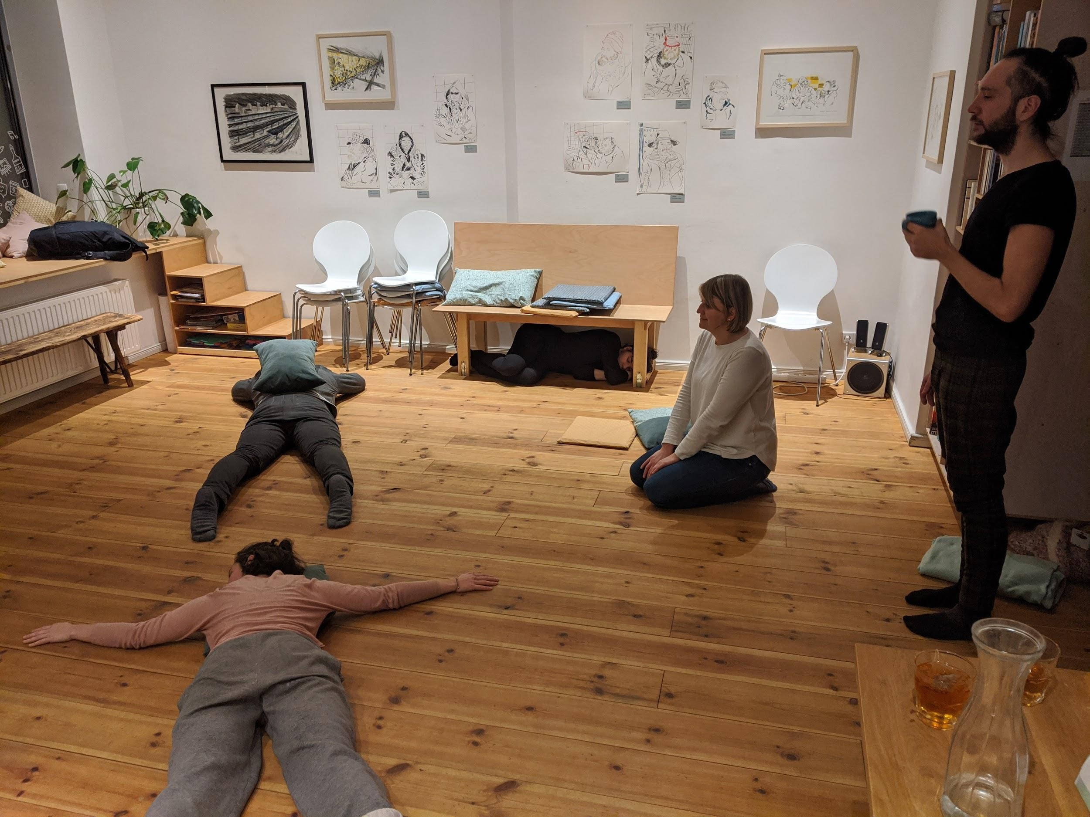
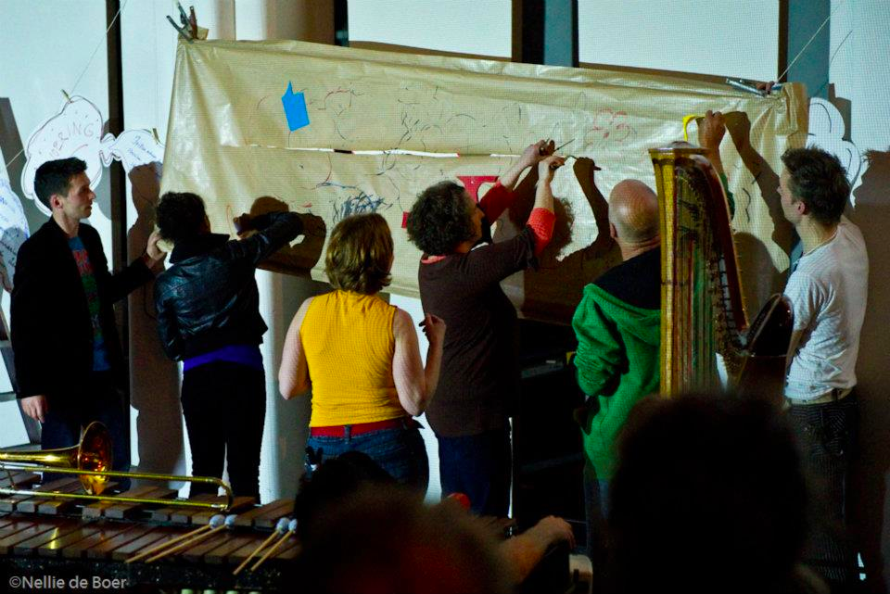
1.3 How can cultural and creative work be made more sustainable, in particular linked to/ after Covid-19, as well as from a green perspective: going beyond the logic of ‘big events’ and hypermobility?
Picture by Michael Dobbie
Picture by Marije Nie
Notes:
In this picture we can see a movement commons practice space; an example of embodied practice.

Slide 14
Our 5 Keywords
Challenge Nr 1: The commons as ecosystems for culture after Covid-19
Please insert here 5 keywords that best describe your proposal.
Fragmentation, resources, sustainability, community, exchange
You should also post these on menti.com. The code for menti.com will be announced on Slack.

