Slide 1
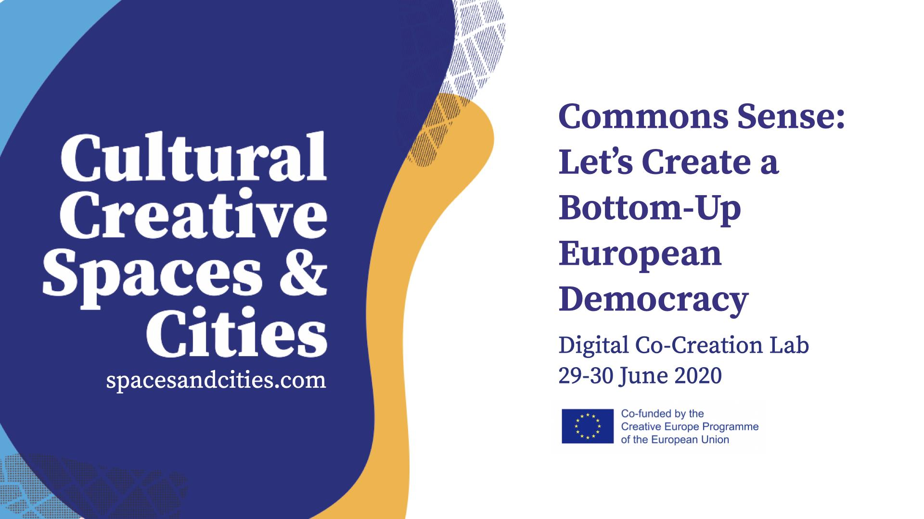

Slide 2
Commons Sense: Let’s Create a Bottom-Up
European Democracy
Digital Co-Creation Lab
29-30 June 2020
spacesandcities.com

Slide 3
Proposal Submission Instructions
Dear team,
please use this format to deliver your proposal. We ask you to provide an analysis and a concrete proposal for each of the subtopics of the challenge you chose to focus on. Finally, we ask you to write 5 keywords for each subtopic (slide 12). If you think that one or more of the subtopics is not relevant, you can provide an alternative solution (and keywords) to the challenge, giving a reason why you deem the original subtopic not relevant.
Any doubts?
Check the guidelines!

Slide 4
Co-Creation Lab Proposal
Challenge Nr 3: Building spaces of encounter between local and EU level
Team 7
Names of team members:
Paula Moore
Katarina Scott
Marije Nie
Shadowed by Mateja Stanislava Rot

Slide 5
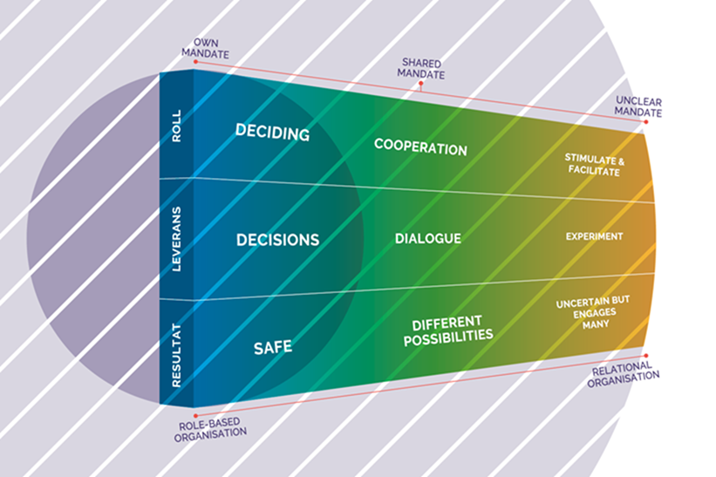
Unlocking, increasing and inter-linking spaces in a village, town, city, urban or rural contexts. Spaces. Practices. Methodology.
The Problem
In the way that we are structured (EU - states - cities - citizens) there is a gap between locals and the EU. What can really bridge that gap?
The Proposal
We propose that there is a mindset and strategy that can unlock this connection and effectively link the EU and the local level, citizens and communities. We call this “the Green”, this comes from a model of innovation, platform and cluster management, adapted by the city of Lund together with the Ministry of Innovation in Sweden.
Work has identified that the EU is functioning in the blue zone (rigid) and the local initiatives are often in the yellow (agile). The green space can act as the connector. The problem we have identified is that there are very few green spaces and people who do work in this space are isolated. The Green also represents a powerful and under-used part of artistic practice: the power to make connections, creative dialogues and to be present by exploring movement, voice work, story telling…
The Approach
What is the Green space and how can it operate? We propose that the Green space is a strategy, a role, and a practice. It can be at the core of the Homes of Commons and be part of people’s jobs, activities and practices elsewhere.

Slide 6
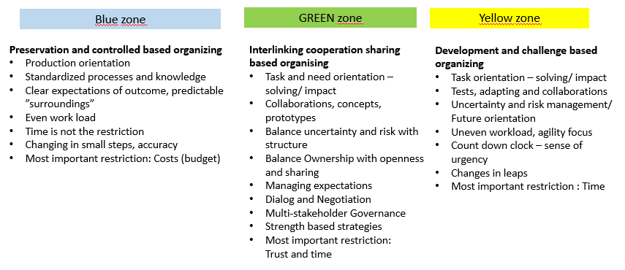
Inter-connection. Agile. Social Architecture.

Slide 7
Social Architecture
!
How can the Green be manifested and put to practice?
The Homes of Commons are the places where the ‘Green’ can be the core focus, where it can be celebrated, shared and practiced.
Arts and embodied practices are at home here, and central to the sharing of green practices. This green practice is one of social architecture, citizens and (local) governments are active partners in dialogue, exchange, open consultation and decision making.
Social architecture enables the democratic process to be inclusive. The Homes of Commons is also involved in facilitating green zone match-making, research of trends and needs, education and practice, library of resources, and importantly the celebration: the Green Zone Carnival!
Essential to creating the Green Zone we see a specific role that needs to be supported and facilitated: the Green Zone Connector.

Slide 8
Keys for Success in the Green Zone
Inclusive negotiation and dialogue to include local citizens, more stakeholders and local authorities.
Strength based approaches; allow risk and failure as a legitimate part of development.
Create a neutral space to enable and encourage meetings between citizens, stakeholder authorities. .
A space to explore, play and experiment together.
Right to decline or say no.
Reward contribution and sharing.
People with Green Zone skills.

Slide 9
Funding and Incentives
Grants in the Green Zone
Need:
To open up the Green Zone between different stakeholders (Blue - Yellow). Foster and create interlinking, cooperation and sharing.
Making parts of the grant system agile for rapid change and bigger risks. Allowing grants to be adaptable and responsive. Focus on “the how” of co-operation and sharing as well as outcome, numbers and impact.
Include terms in programs and grants to include open knowledge, sharing and adding to the commons for local stakeholders and citizens for example artists, entrepreneurs, heritage, cultural, youth workers… Add smaller funding and cascade funding to inter-link the green and yellow zones to focus on connecting to other initiatives, projects and work. Cross-border; disciplines, projects, territories.

Slide 10
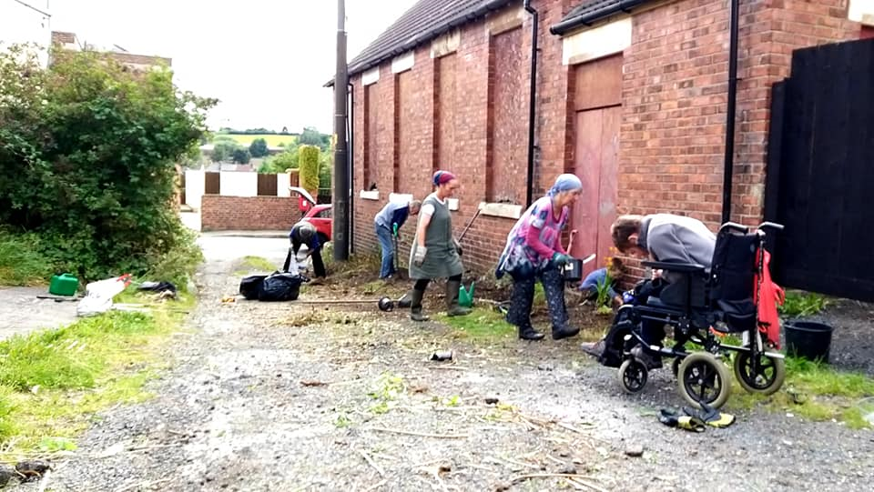
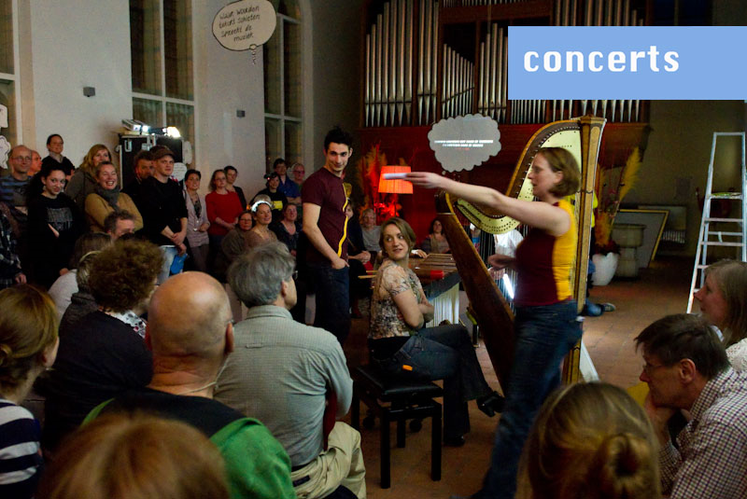
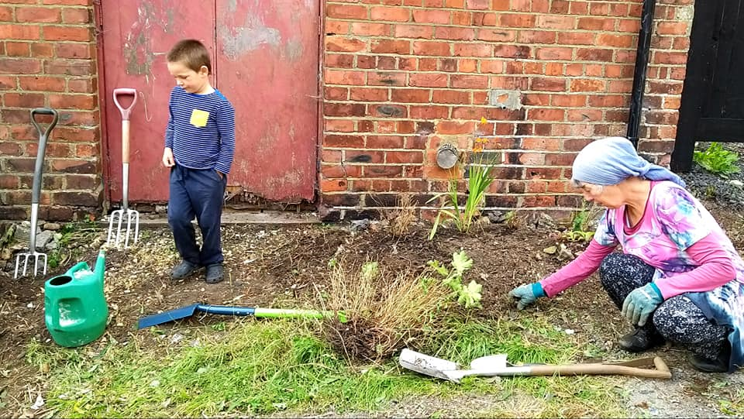
Celebration and Manifestation

Slide 11
3.3 Homes of commons and cultural and creative spaces: how can we rethink cultural and creative spaces as community organisations suggesting new ways for the EU to relate with the local level, aware of the role of relevant national/regional level organisations ?
What is your Analysis? Please explain your reasoning here. You can use use text, photos, drawing, video, illustrations, graphs, whatever!

Slide 12
3.3 Homes of commons and cultural and creative spaces: how can we rethink cultural and creative spaces as community organisations suggesting new ways for the EU to relate with the local level, aware of the role of relevant national/regional level organisations ?
What is your Concrete Proposal? Please explain and illustrate here. You can use use text, photos, drawing, video, illustrations, graphs, whatever!

Slide 13
3.3 Homes of commons and cultural and creative spaces: how can we rethink cultural and creative spaces as community organisations suggesting new ways for the EU to relate with the local level, aware of the role of relevant national/regional level organisations ?
What is your Concrete Proposal? Please explain and illustrate here . You can use use text, photos, drawing, video, illustrations, graphs, whatever!

Slide 14
Our 5 Keywords
Challenge Nr 3: Building spaces of encounter between local and EU level
Please insert here 5 keywords that best describe your proposal.
You should also post these on menti.com. The code for menti.com will be announced on Slack.

