Slide 1
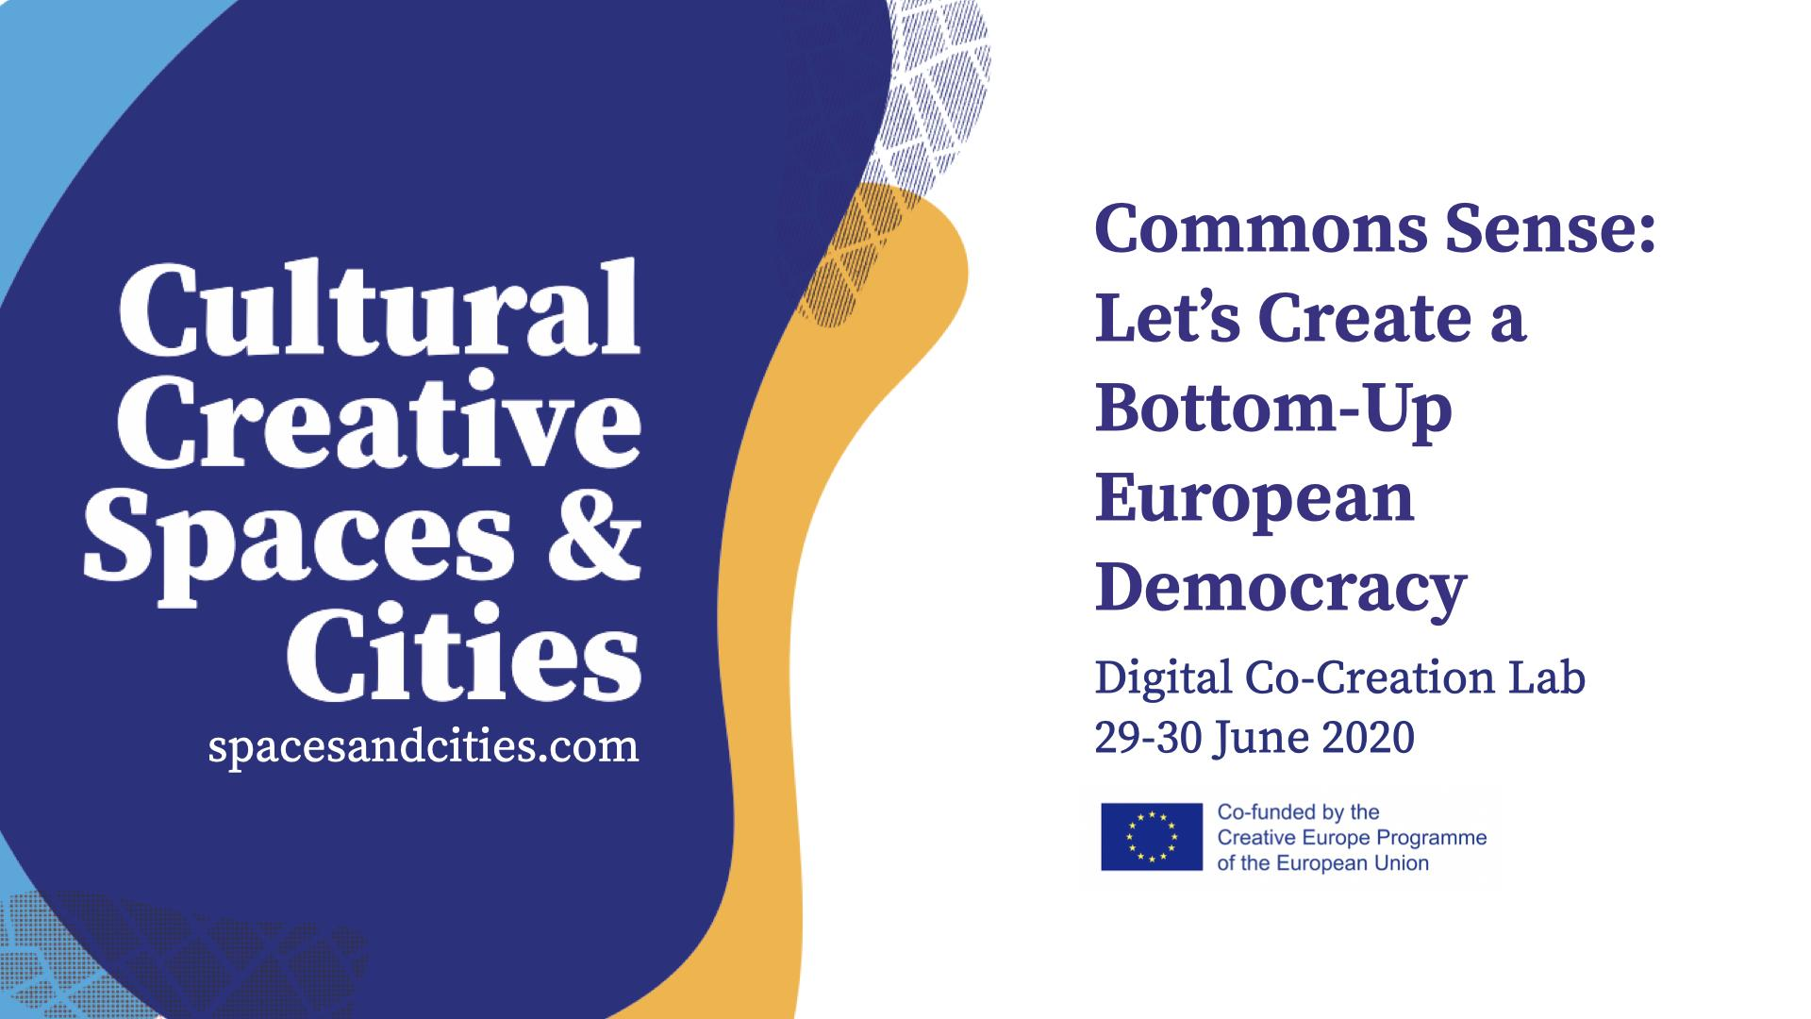

Slide 2
Co-Creation Lab Proposal
Challenge Nr 2: Co-creating cultural policies in cities to foster cohesion and inclusion
Team 1 - Concordia
Names of team members:
Reem Maghribi, Mariia Varnava, Adrian Plesca, María Jesús Morillas, Lisanne Corijn

Slide 3
ANALYSIS
2.1 Incentives to participation: should remuneration (financial or non-financial) be included in participatory processes?
Barriers to participation:
> Lack of culture in community building (result of authoritarian rule)
> Lack of time
> Lack of knowledge & awareness of opportunities
> Perceived lack of authority respect for individual cultural rights
Incentives to participation:
1. Financial remuneration
> Commercialises a social endeavour
> Not sustainable
> Does not reflect engagement with purpose
2. Non-financial remuneration (in-kind contributions)
> Directly supports activities that enhance participation & inclusion
> More likely to promote sense of purpose and belonging

Slide 4
ANALYSIS
2.2 Culture in Urban Policy: how to overcome in-silos approaches in urban policy? Can cross-sectoral approaches; needs-based approaches; stronger mediation/facilitation work as solutions?
Existing silos:
Civil society orgs
Community organisations
Private sector
Education institutions
Religious spaces
Individuals
Municipal authorities
Nationalities
Barriers to cooperation:
Communication & Language (terminology)
Need for control
Time
Corruption / loyalism
Competition for resources
Access (transportation, internet,
tech saviness)
Lack of trust and credibility
Lack of dedicated community managers
Lack of resources dedicated
to events that bring ppl together
Potential formation factors:
Age
Geography
Gender
Interests

Slide 5
ANALYSIS
2.3 Participation and post-covid Europe: in what ways can local authorities recognize, valorize and support local solidarity initiatives?
Most local authorities have already established community spaces that can bridge existing initiatives and instigate supportive activities
Networking (not co-opting) traditional community services (libraries, theatres, gyms, etc) to support and present a more holistic inclusive “community space”
Infrastructure (e.g. community centre) & services (e.g. sport activities) are not enough to bring people together and foster local solidarity initiatives; tailored activities aiming towards inclusive community engagement, with each other and with decision makers, is needed
Provision of initiatives and events that address local community interests and foster a common sense of belonging may enhance solidarity
Honest relations fueled by full transparency between CSOs / local communities and local authorities may enhance participation

Slide 6
PROPOSED STRATEGIC ACTIVITIES for supporting INCLUSIVE COMMUNITY BUILDING
1. Ensure a community space exists & expand it when possible
Almost all European cities and towns include some services and places - funded by the municipally of other non-profit entities - in which community members congregate, such as:
Working space (enable proactive & on-spot collaboration)
Cafeteria
Creche / playplace
Library / language center
Outdoor space / common gardening centre
Auditorium / Theatre
Gym
Skatepark
These elements may be built by the municipality, but it may be better and more inclusive to “incorporate” existing services run by other non-profit entities - through support and mutual engagement - into a more expansive co-owned “community space”

Slide 7
PROPOSED STRATEGIC ACTIVITIES for supporting INCLUSIVE COMMUNITY BUILDING
2. Ensure a dedicated individual or team associated with the “community space” focuses on facilitating inclusive community engagement
Options for dedicated community engagement facilitator:
Rotating responsibility (among existing community space staff)
for when no budget can be dedicated to the role
Dedicated individual, hired by credible body (local authority, community space board, CSO cooperative)
Establish diverse task force, which includes members either from existing community space staff members or from diverse CSOs
to work independently or in cooperation with dedicated facilitator
Considerations:
Ensure diversity within engagement team
Consider credibility of hiring body among various communities when determining which entity should employ the manager/team

Slide 8
PROPOSED STRATEGIC ACTIVITIES for supporting INCLUSIVE COMMUNITY BUILDING
3. Regularly organise events that bring people together as participants and not only observers. Examples of such activities include:
Debates with people from different backgrounds: social, cultural, economic, professional...
Regular informal “meet the community” events - with spotlight on different individual each time - local business owners or community organisers, ensuring inclusivity
Open dialogue lunches (participants as mediators)
Gardening initiative (cleaning and maintaining common spaces - playgrounds, parks, public beaches)
Community-led urban regeneration, for example art installations in abandoned spaces (poss. cooperation with artists)
Cooking club or festivals: organized by type of food (veg, healthy, vegan, desserts, soups, fish….), not nationality (which divides rather than unites)

Slide 9
PROPOSED STRATEGIC ACTIVITIES for supporting INCLUSIVE COMMUNITY BUILDING
4. Ensure Outreach is Inclusive (inviting the unusual suspects)
unusual suspect (def) - people who are not usually considered or remembered in a particular context (eg: immigrant communities in European Cities)
Use language that is inclusive and unites
Ensure individuals / groups that create / manage / nurture / support each part of the “community space” is acknowledged
Reach diverse communities through:
Physical space with info points highlighting events + letterbox to promote & propose events
Desks at int’l festivals
Handing out flyers (in local stores, door-to-door,...)
Social networks & specific targeting strategies (social media, websites, digital promotion)
Community leaders / influencers / organisations (extending invitations and attending their organised events to close gaps)

Slide 10
PROPOSED STRATEGIC ACTIVITIES for supporting INCLUSIVE COMMUNITY BUILDING
5. Adapt to virtual spaces to expand opportunities, particularly during times of essential isolation
Create alternative designs for activities during isolation. Examples:
Individuals co-create and publish sketchbook online and print for physical distribution post-isolation;
People design kites while engaging online and fly them post-isolation
Book club members write a part of a story and pass to another member to continue
Overcoming the digital gap:
Utilise the most commonly used social messaging platforms to reach widest audience (WhatsApp, Viber, etc) and share information; ensuring all activities widely promoted to diverse groups to maintain inclusivity
Ensure physical world actions included as much as situation allows for

Slide 11
PROPOSED STRATEGIC ACTIVITIES for supporting INCLUSIVE COMMUNITY BUILDING
An overview of the proposed strategy and initiatives:
1. Ensure a community space exists – expand it when possible
2. Ensure a dedicated individual or team focuses on building inclusive community engagement
3. Organise events that bring people together as participants not only observers
4. Ensure Outreach is Inclusive (inviting the unusual suspects)
5. Make best use of virtual spaces to expand engagement, particularly during times of essential isolation

Slide 12
Our 5 Keywords
Challenge Nr 2: Co-creating cultural policies in cities to foster cohesion and inclusion
holistic
mediation
outreach purpose
belonging
You should also post these on menti.com. The code for menti.com will be announced on Slack.

