Slide 1
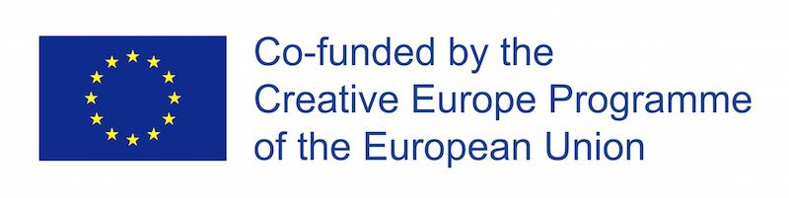
Commons Sense:
Let’s Create a Bottom-Up
European Democracy
Digital Co-Creation Lab
29-30 June 2020
spacesandcities.com

Slide 2

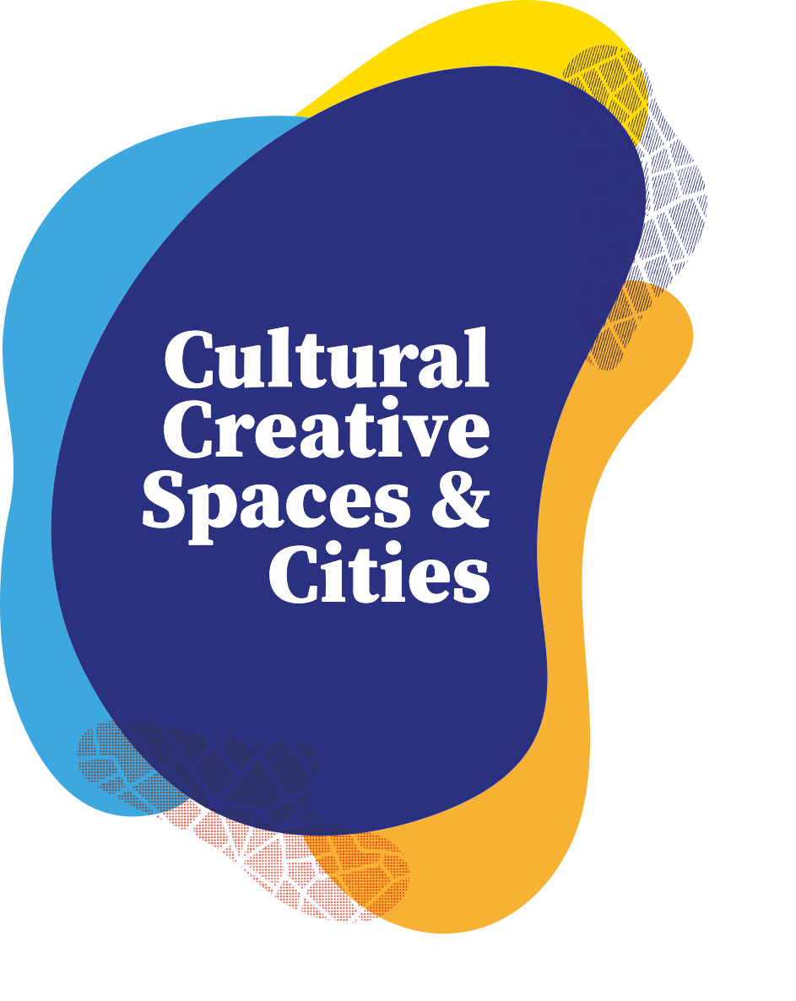
Co-Creation Lab Proposal
Challenge Nr 3:
Building spaces of encounter between local and EU level
Team 11:
Spiritual Commoning
Names of team members:
Michael Dobbie
Sonya Armaghanyan
Evan Reinhold
Marije Nie
Mateja Stanislava Rot

Slide 3
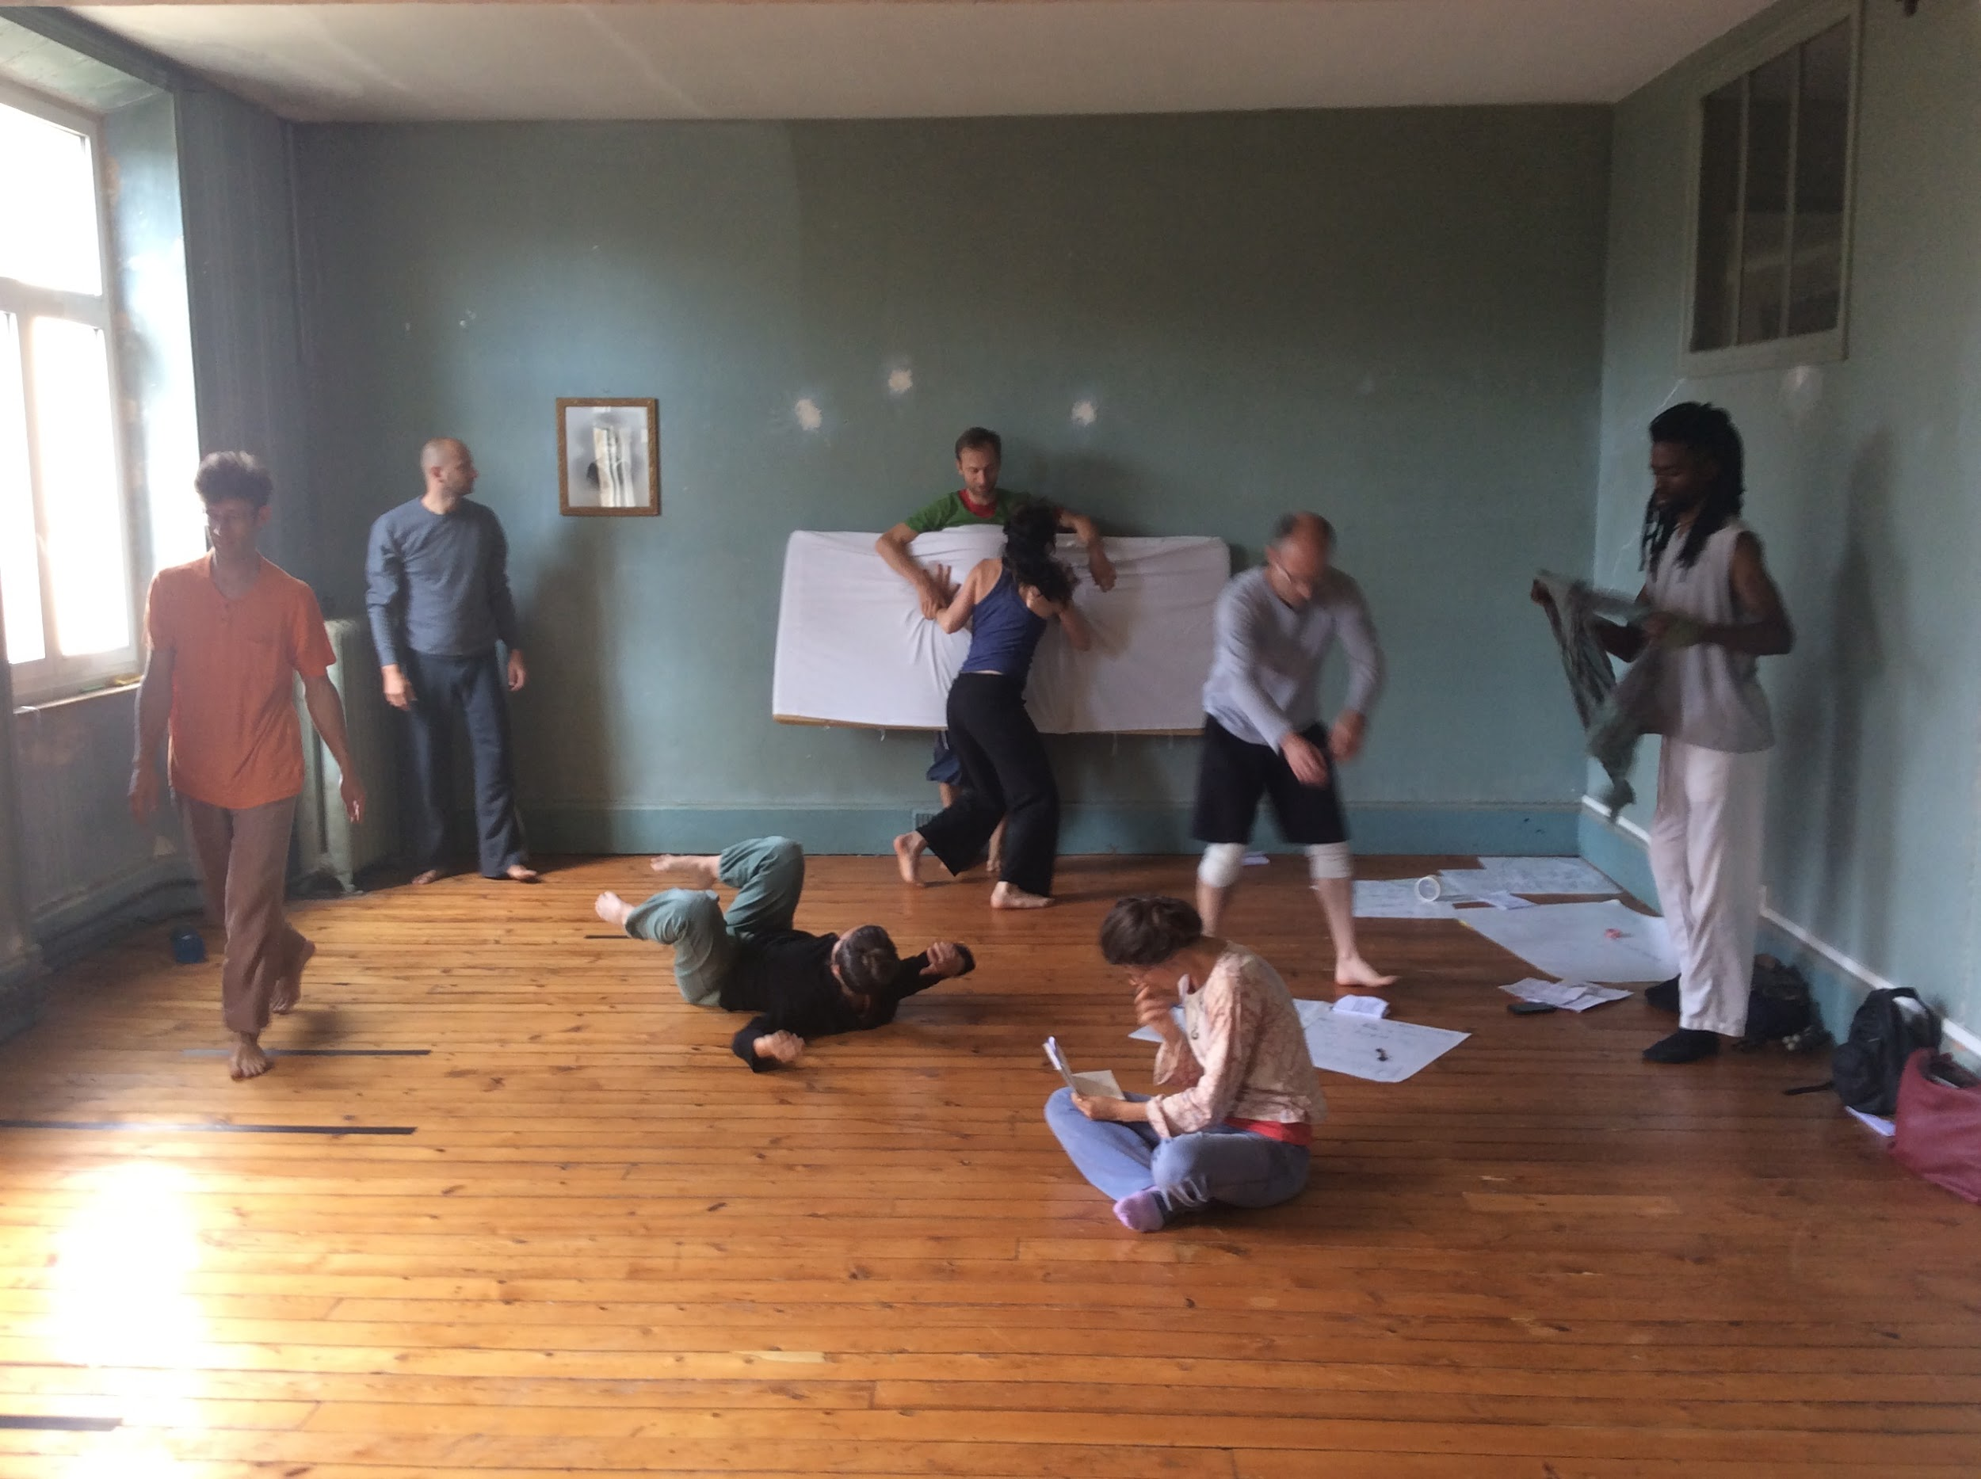
Unknown Directions:
the Spiritual Commons

Slide 4
Context and Perspective:
The commons often seem like an ambiguous, even abstract idea. Yet they hold the potential to contain and enable all of who we are, to frame how we see the world, how we relate and interact with one another…as humans, as Europeans…reaching through all levels of self and society.
The commons already exist in rudimentary ways, but their full potential require tending and feeding through shared awareness and practice. The commons are a continuous, evolving, creative act of the imagination. It is a shared collective dreaming. In the same way as an open improv the commons thrive on the inspirations that we’re each able to offer one another…open, vulnerable human acts of art, curiosity and play...continual trial and error. Transparency and trust are core principles in this process of creation. How to then enable more of us to become visible and open to one another, to stay inspired, to play our part in these Commons as or when needed? Each of us (as citizen in potential) plays a unique individual role in this tapestry, these common spaces of the body, mind and environment. But it’s a learning process to stay engaged and connected…to keep such commons alive, open, inviting and present for all. This
awareness and tending to a shared physical and mental commons requires some good
framing and design.
And so we begin in framing here with the idea of the “spiritual commons”.

Slide 5
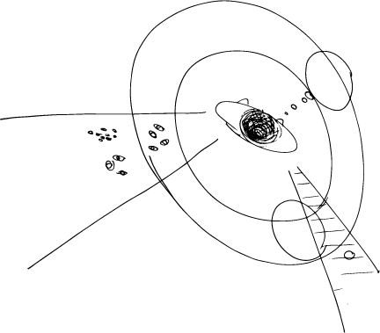
taking time and space to enquire around a collective spiritual commons
An understanding beyond three dimensions...into spaces transcending present limitations, definitions and language...
into new practices, rituals?
How to embody the EU in
daily life?
Personal / collective thoughts
Communities
points of contention
overlap, diversion, and collision

Slide 6
3.1 Concrete proposals to bring Europe closer to citizens and cultural operators -- Organisation of the ‘homes of commons’: how can homes of commons act as effective tools to decentralise EU institutions and foster a dialogue with the local contexts? How can homes of commons communicate and collaborate simultaneously with EU institutions, local authorities and citizens?
Analysis: Our natural commons is a harmony of trees, land, water, air, tended and cared for. The built commons are designed and maintained, through laws, codes of conduct and other structures. The Spiritual Commons however, exist everywhere and nowhere. This resource requires some sort of collective consciousness to be understood.
These unrealised collective (common) dreams, intuitions and futures require better framing and language...time and space for unique processes, practices and rituals of listening, sense making and dialogue to develop. Such commons can only be accessed and opened to in spaces that are safe for humans to be human (or Europeans still learning to be European). These are spaces where our diversity, human honesty, vulnerability, messy creativity and chaos can awkwardly sit side by side, together with the unknown….essential skills for these unpredictable times.
These are spaces of encounter where bits of our humanity slowly find some bits of
home and grounding. Spaces where the embodiment of our human story (body, mind
and soul) can take integrate, to eventually represent fully who we are.
This is placemaking. Personal, Public and European.

Slide 7
These spaces of encounter are built deep but must also remain alive in spirit...agile and adaptable to present moment changes. They are built over time and within very local context and yet are also mobile in the sense of shareable core human practices, rituals and principles of sense making, design, hosting and care (for humans to be human, to be heard, understood and coherent).
These are spaces to engage public dreams, imagination and reveal collective wisdom. Flexible and adaptable to the stories that need to be told, to the needs of the moment and time. They are spaces of listening, witnessing, new practices and prototyping of relevant new social forms as needed. Spaces of social innovation where the creative process has become democratised for all to feel encouraged and curious to take part. The future is something we all must be engaged to discover...not just few leaders. All must lead in their unique fashion, but also with good self-awareness...willing to make mistakes while learning to experiment safely, to improvise and fail without fear. This is the commons that need to be created for every ‘citizen-in-potential’ to become Citizen. This Citizen is self-educated while also learning how to learn within a local collective.
With such spiritual commons we simply start anywhere, we begin where we can, as we
can, we listen, we improvise, we create. This is culture change at it’s very core…in
support of our human nature, our spirit and it’s development within a commons that
respects and engages each one in their unique story and path.

Slide 8
3.1 Concrete proposals to bring Europe closer to citizens and cultural operators….
How or where do we ‘experience’ the commons now? Not only places or spaces but in the way we feel it? In experiences of human common sense making, shared dialogue and dreams? What are the ways you are motivated to act in collaboration to create experiences of common benefit, mutual aid and care? Where do you feel creative, encouraged to share your story or to dream?
We propose more intimate, closer relationships with one another, with the public in co-creating new experiences and prototypes for Spaces of Encounter. These are European labs and spaces for citizens to discover how to more fully engage, to embody their ideas and dreams, to be inspired to listen, learn, facilitate and host themselves. Europe must connect closer more than ever, to learn to host itself back to itself in mutual aid and care, to create spaces made for the citizen to be born into his/her/their unique, neuro-diverse identity. Each creatively enabled to re-discover self and belonging...as individual and collective (community and nation)...a commons in continual renewal.
Our spontaneous group #11 barely began to form and to build personal common points of
what this is for each of us. We have identified time/space/practices/processes and rituals
as essential to spiritual commoning. A small online experiment that we gave ourselves
some moments for is included in following photos. We wish to continue this work
begun, to expand our prototyping and continue to widen the circle among others..

Slide 9
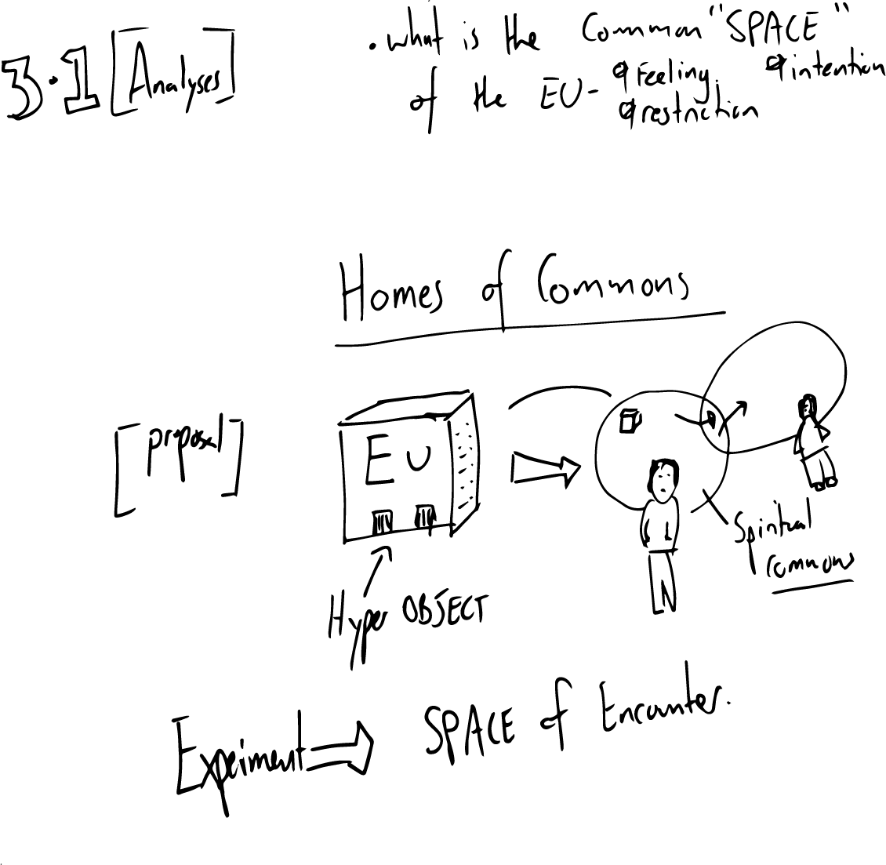

Slide 10
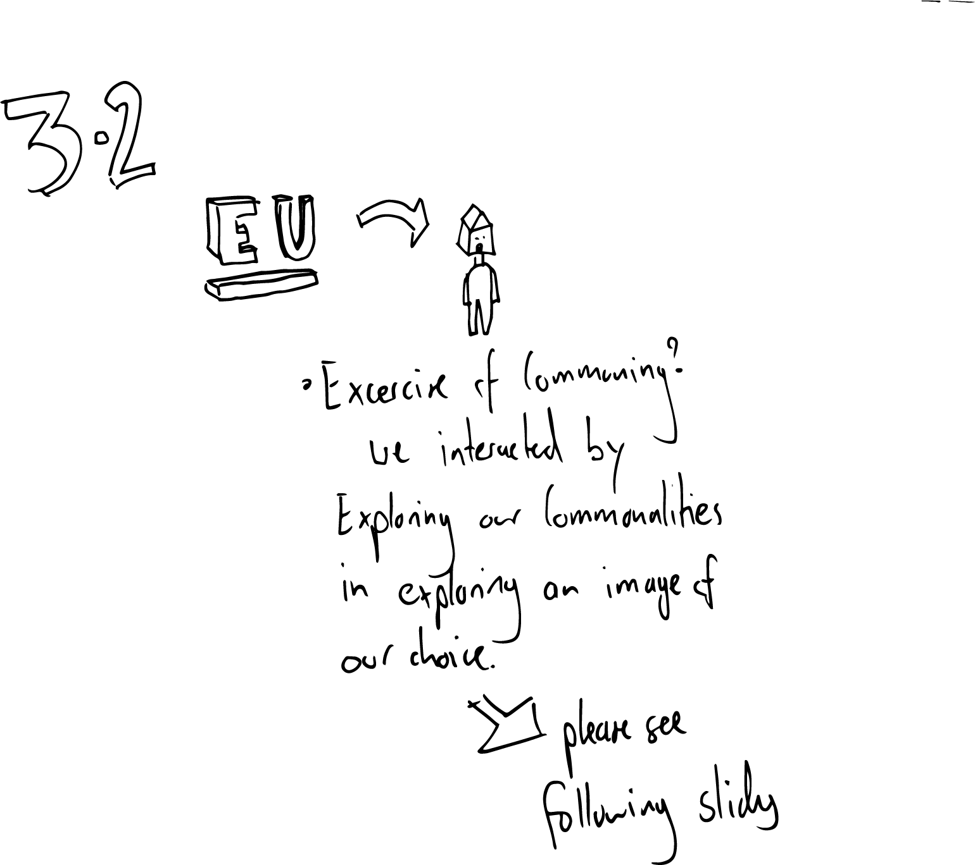
3. 2 Concrete proposals to bring Europe closer to citizens and cultural operators – Agenda of the homes of commons: what should be on the agenda of homes of commons, in order to facilitate the links between the EU and the local level? What function should homes of commons have (advocacy, information, co-creation, local participation…)?
Analysis
Exercise in how we can get into the same space / frame of mind?

Slide 11
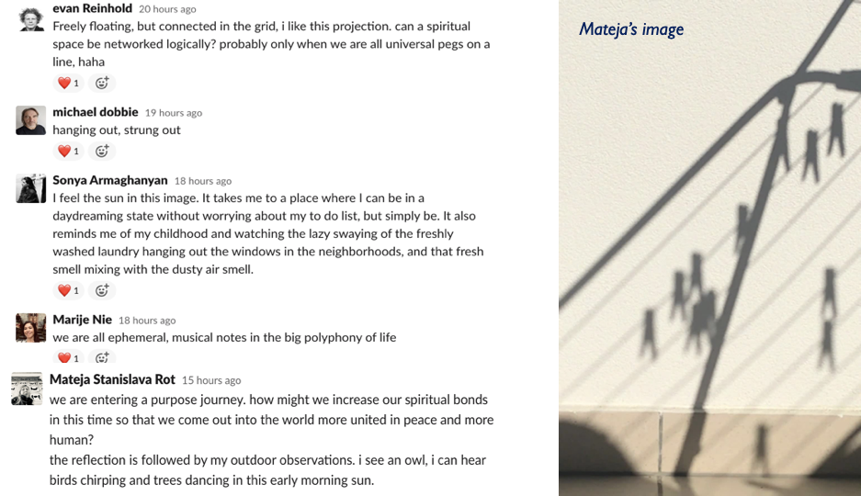

Slide 12
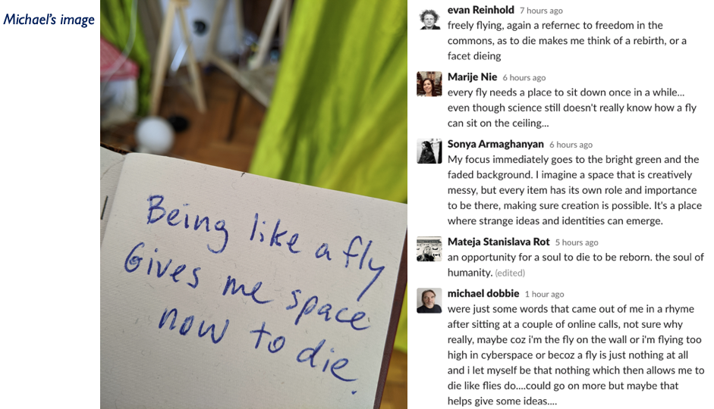

Slide 13
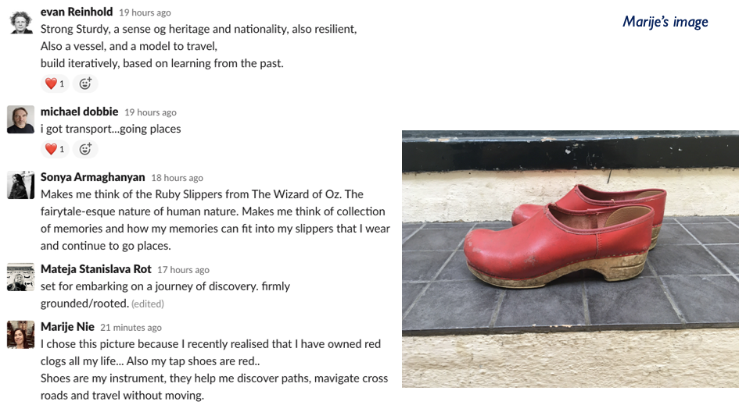

Slide 14
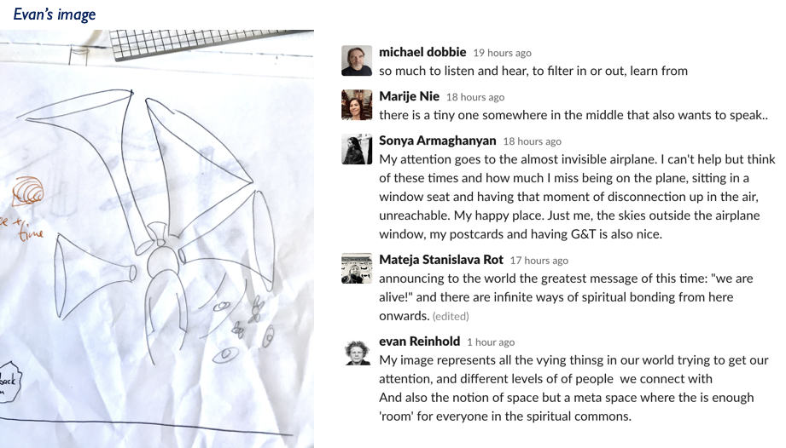

Slide 15
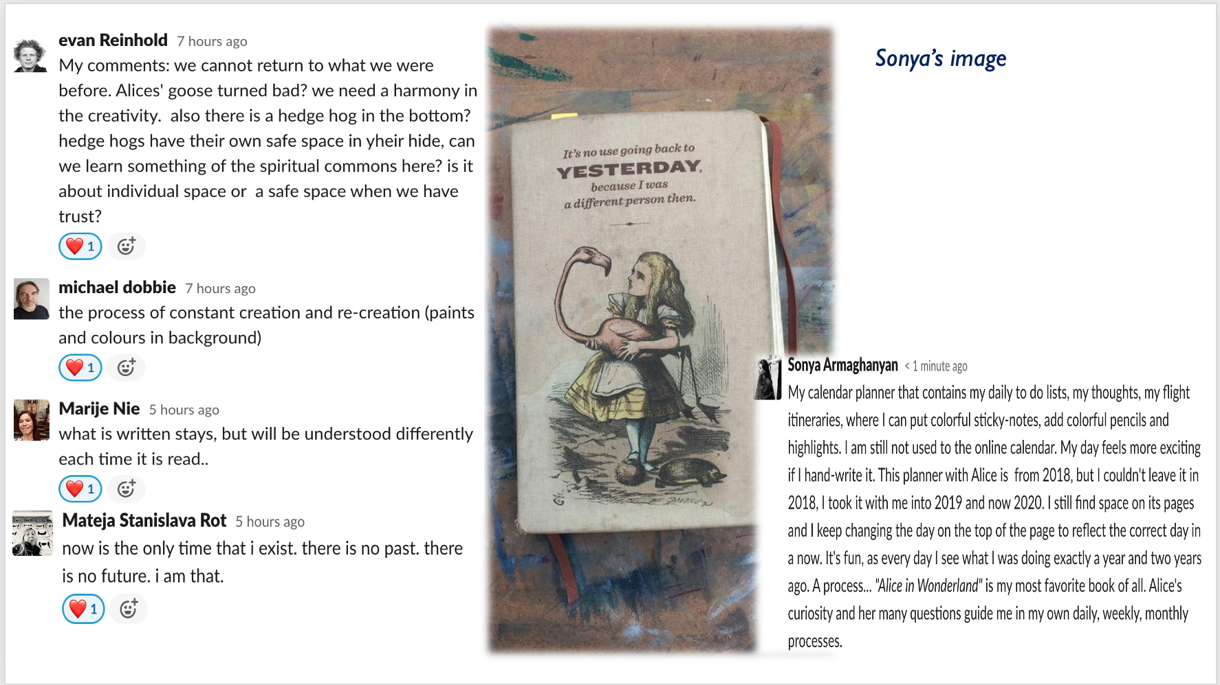

Slide 16
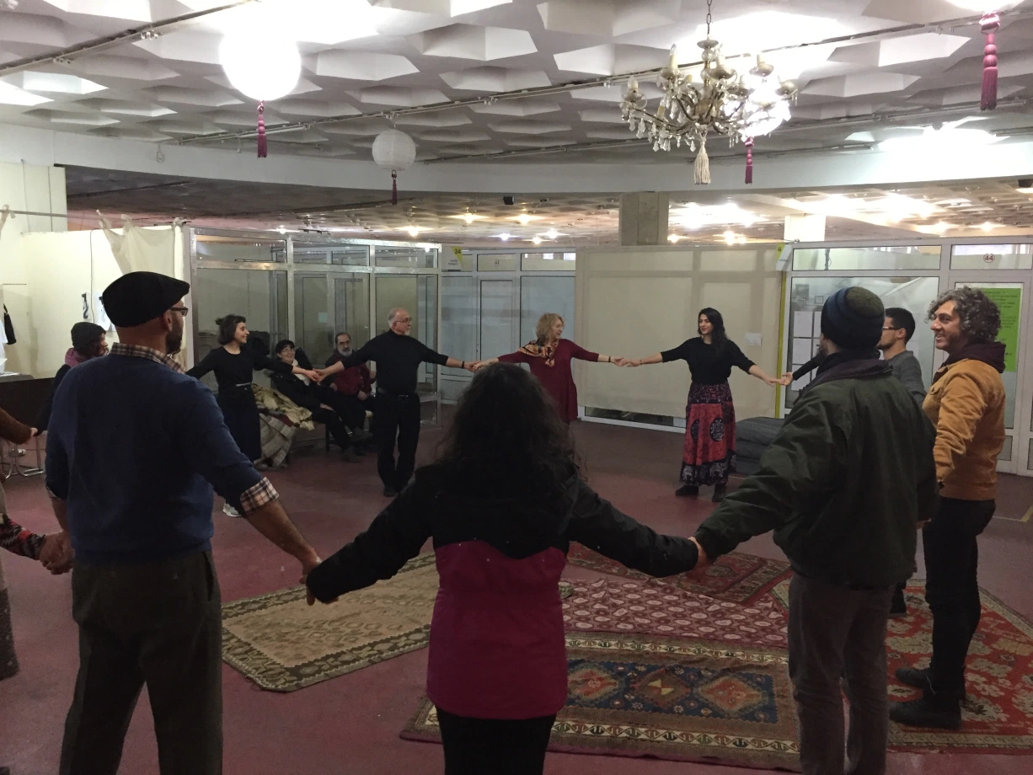
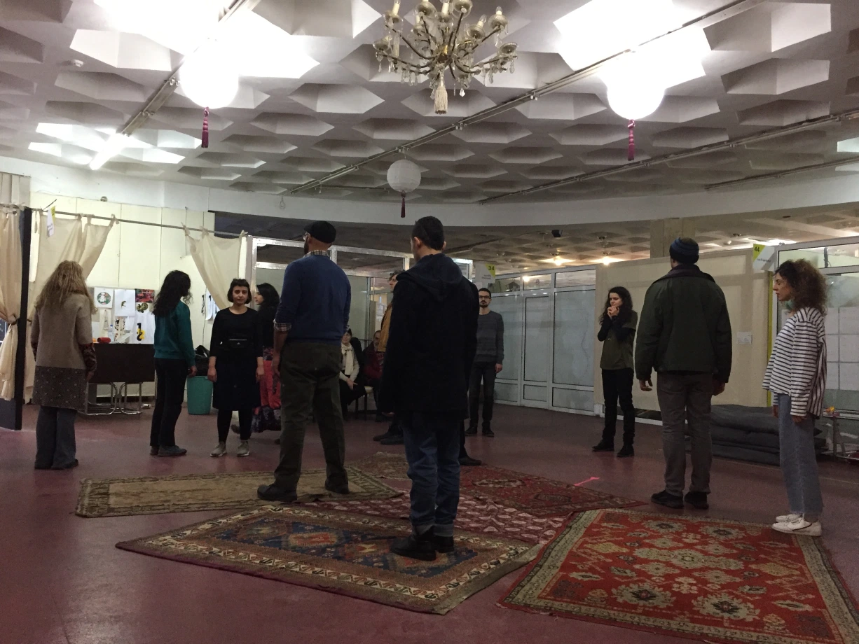
“Where is Home?”
Performative workshop combining elements from theatre and dance movement to explore the notion of home and the sense of belonging. A practice in process that uses embodiment to discuss and feel the concept of home and what it means.
Facilitator: Sonya Armaghanyan

Slide 17
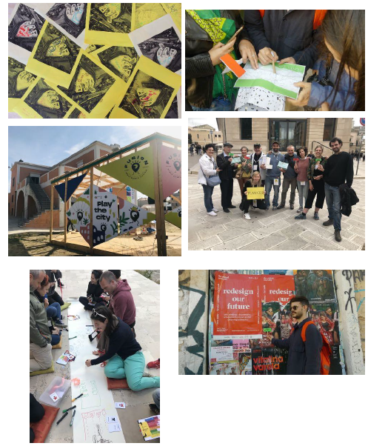
Building spaces of encounter through urban games
Urban games act as supportive environment for community action that is co-created within safe(r) space. With urban games we are bringing together playful approaches in urban design, storytelling and AR/VR innovation. Throughout the process we hold space for people so that they feel comfortable and motivated to co-create and share their experiences through play. Such spaces of encounter have the potential to uplevel the human connection where people can be more present together and become active co-creators of their environment.
Mateja Stanislava Rot

Slide 18
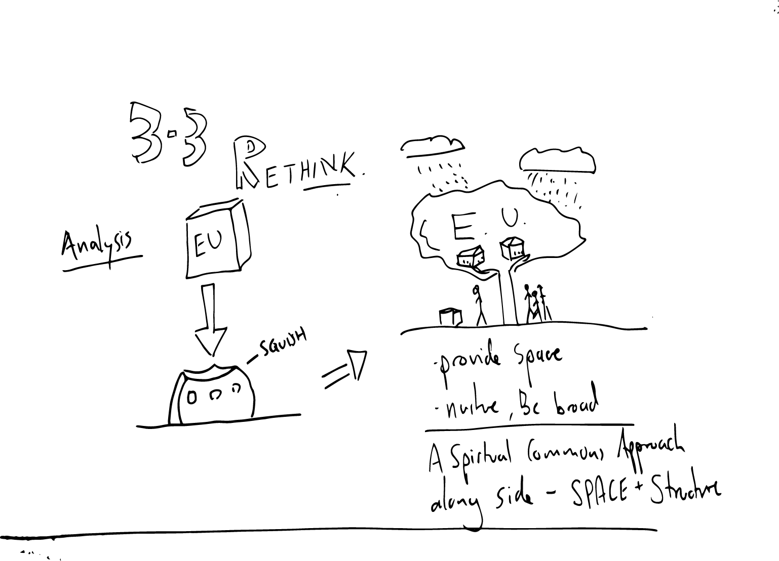
3.3 Homes of commons and cultural and creative spaces: how can we rethink cultural and creative spaces as community organisations suggesting new ways for the EU to relate with the local level, aware of the role of relevant national/regional level organisations ?
Can we rethink The large object of the EU as a more nurturing ecosystem, like a tree, with its needs, dependents, and oppertunities.
Many diverse organisms live on/in a tree and help it trive,
based on a natural understanding of one another,
Nurture / care / safety
Two way relations between the small and the big
Analysis // Concrete Proposal

Slide 19
Our 5 Keywords
Challenge Nr 3: Building spaces of encounter between local and EU level
Spiritual Commons
Spaces of Encounter
the personal is public space
Practice/Process/Ritual
Embodiment

